Slide 1
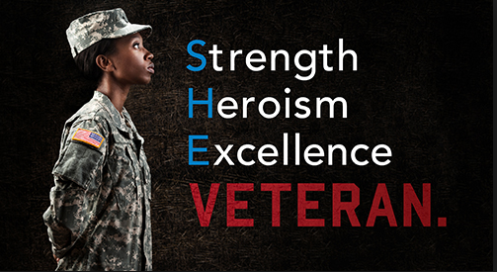
Veterans Affairs and Rehabilitation

Slide 2
What Is the Program and why do we do it?
The mission of the Veterans Affairs and Rehabilitation (VA & R) program is to enhance the lives of US Veterans, Military, and their families.

Slide 3
What Is the Program and why do we do it? Cont.
The VA&R mission continues to address the ALA Centennial Strategic Plan goals in the following ways
Provides members leadership opportunities to serve as volunteers with local Veterans Administration Centers.
Broadening membership pool within the targeted population
Builds brans loyalty within the community and Veterans

Slide 4
What can you do?
Assist in activities that help homeless Veterans!
Contact the Homeless Veterans Coordinators to volunteer services
Ask about specific needs of woman veterans
Knit or crochet hats, scarves and mittens for distribution.
Collect or donated gently used gloves, mittens scarves and hats.
Consider a “Tree of Warmth”

Slide 5
What can you do? Cont.
Contact the Homeless Veterans Coordinators at the Veterans
Administration Medical Center to determine specific needs of your community.
Participate in the VA Project CHALENG to assist homeless veterans in your community.
Connect with Post and Squadron counterparts to explore fundraising opportunities to assist Veterans as risk of losing housing

Slide 6
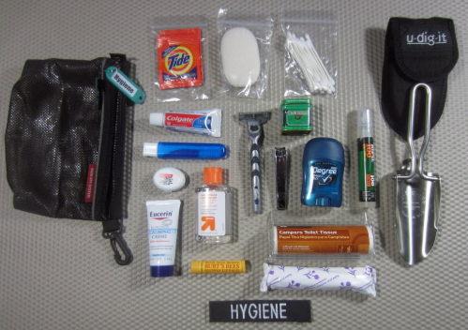
What can you do? Cont.
Host or participate in Stand Down events for homeless where free goods and services are offered
Be mindful to include items necessary to meet specific needs of woman
Assist Veterans locate emergency shelters, transition homes, or permanent housing services within the local community.
Reach out to the coordinators of the programs to determine specific needs such as clothing , hygiene kits, buddy baskets and household items.
Volunteer to prepare or serve meals

Slide 7
What can you do? Cont.
Adopt an identified at risk Veteran to make a personal connection
Compile “Blessing Bags” with personal items to be distributed by local police
Share information, bulletins, e-bulletins and mailings with all members.

Slide 8
Support rehabilitation and healing of Veterans through the Arts.
National Veterans Creative Arts Festival (NVCAF)
A national competition that recognizes progress and recovery through recreational therapy and creativity.
A major goal should be to support this program by increasing monetary support by encouraging department fundraisers to increase program awareness

Slide 9
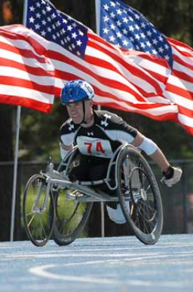
Support rehabilitation and healing of Veterans through the Arts.
Raise member awareness of the ALA Vital role in presenting and sponsoring the National Veterans Creative Arts Festival
Collect and contribute supplies to help supplement Veteran artists needs for projects
Raise funds to help local Veterans attend and compete In the Wheelchair Games, Veterans Creative Arts Festivals, Paralympics and other similar events

Slide 10
Department Special Project
The department special project is to provide needed financial support to local VA Hospitals throughout the State of Virginia. The lack of funding for VA Hospitals is a well known, documented issue within the state. By focusing on the needs of the VA Hospitals within the state; we can provide assistance and bring to light the current unmet needs of local veterans due to the lack of funding.

Slide 11
Department Special Project
Please send all donations to the department secretary, earmarked “VA&R Special Project”
We are an organization for veterans and this is our opportunity to make a difference within our State!

Slide 12
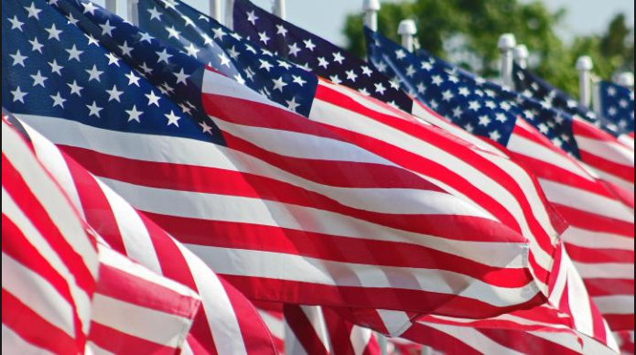
Thank You!

