Slide 1
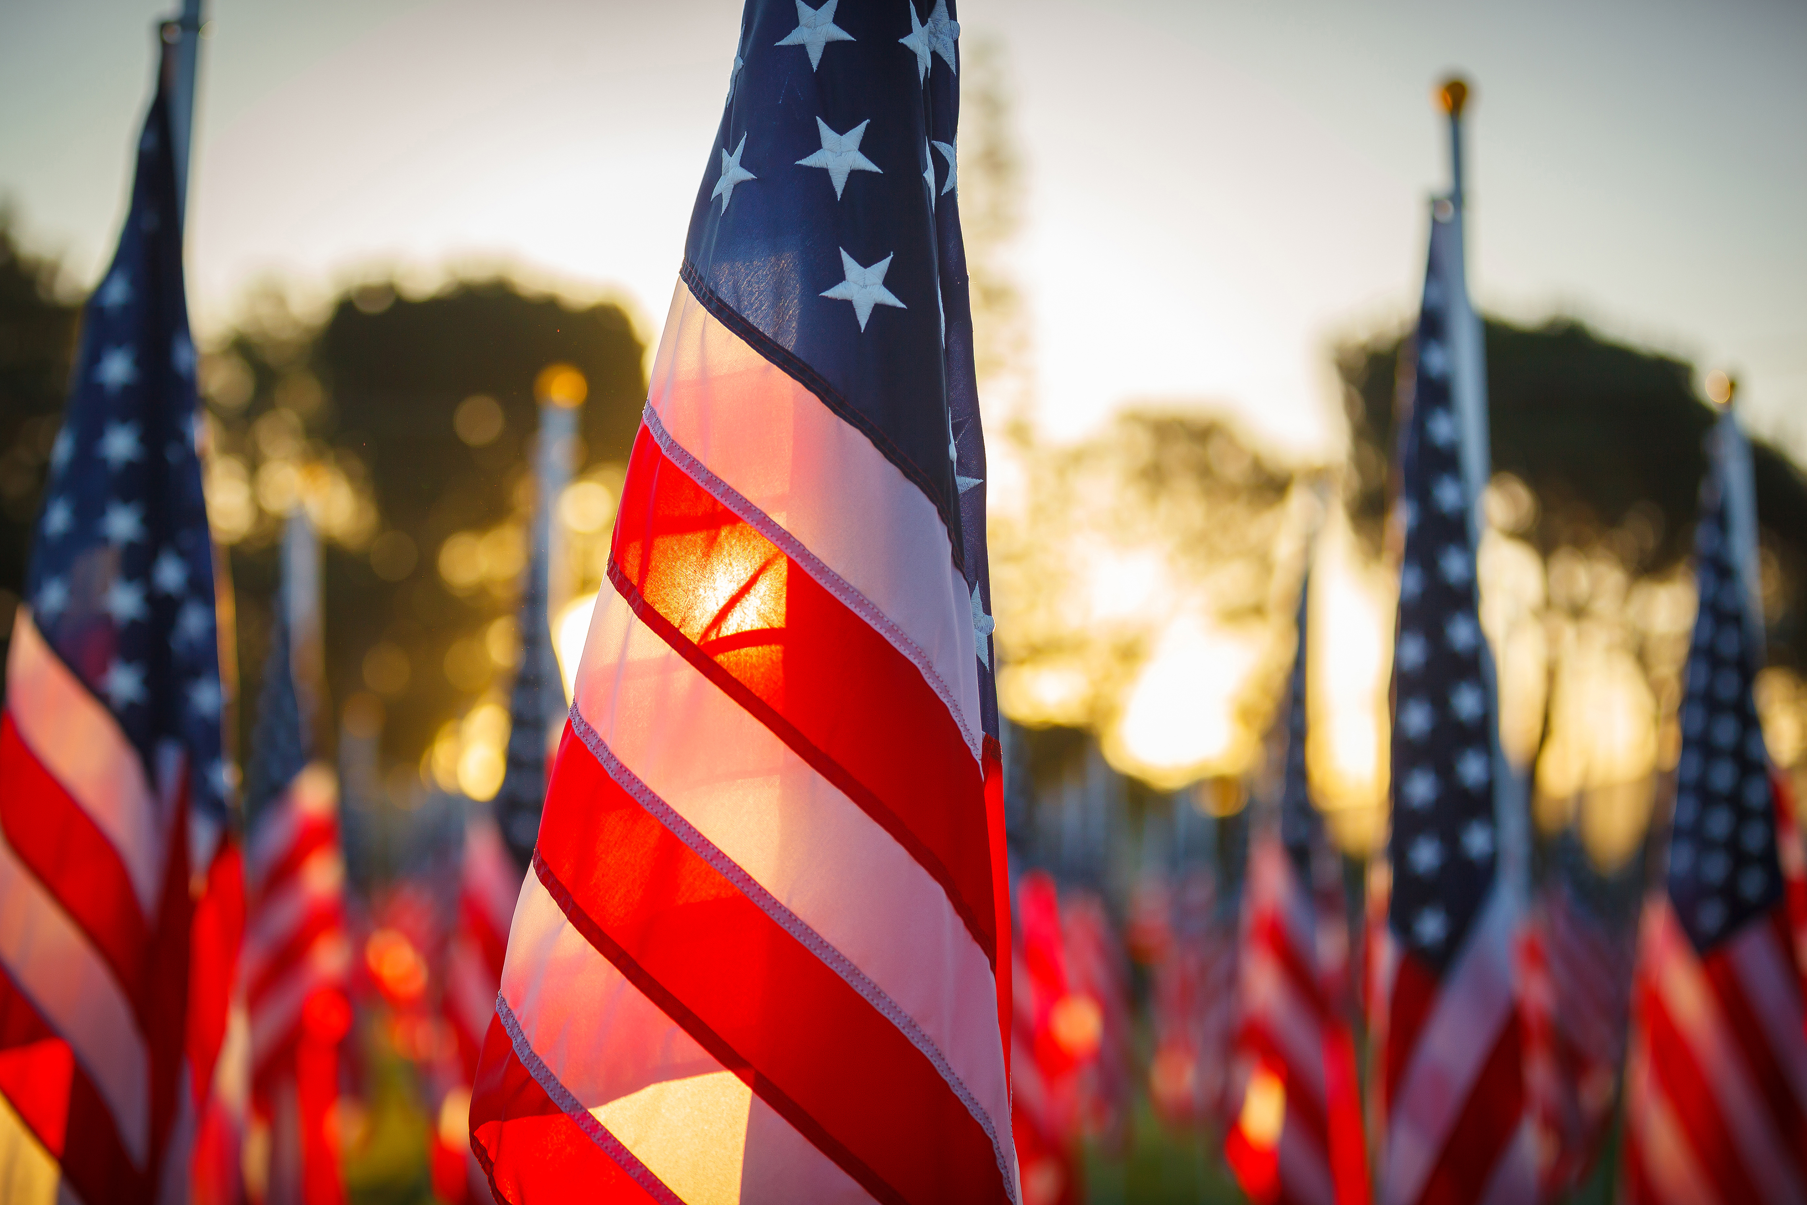

Department of Virginia Americanism 2025-2026 “ Serving Our Veterans, Military, and Their Families” Chair Vice Chair Dr. Deborah Blanch Ginger Harvey deborahblanchnatauxiliary@yahoo.com gch1130@aol.com (757)288-9757 Bonnie Crews, PDP Advisor

Slide 2
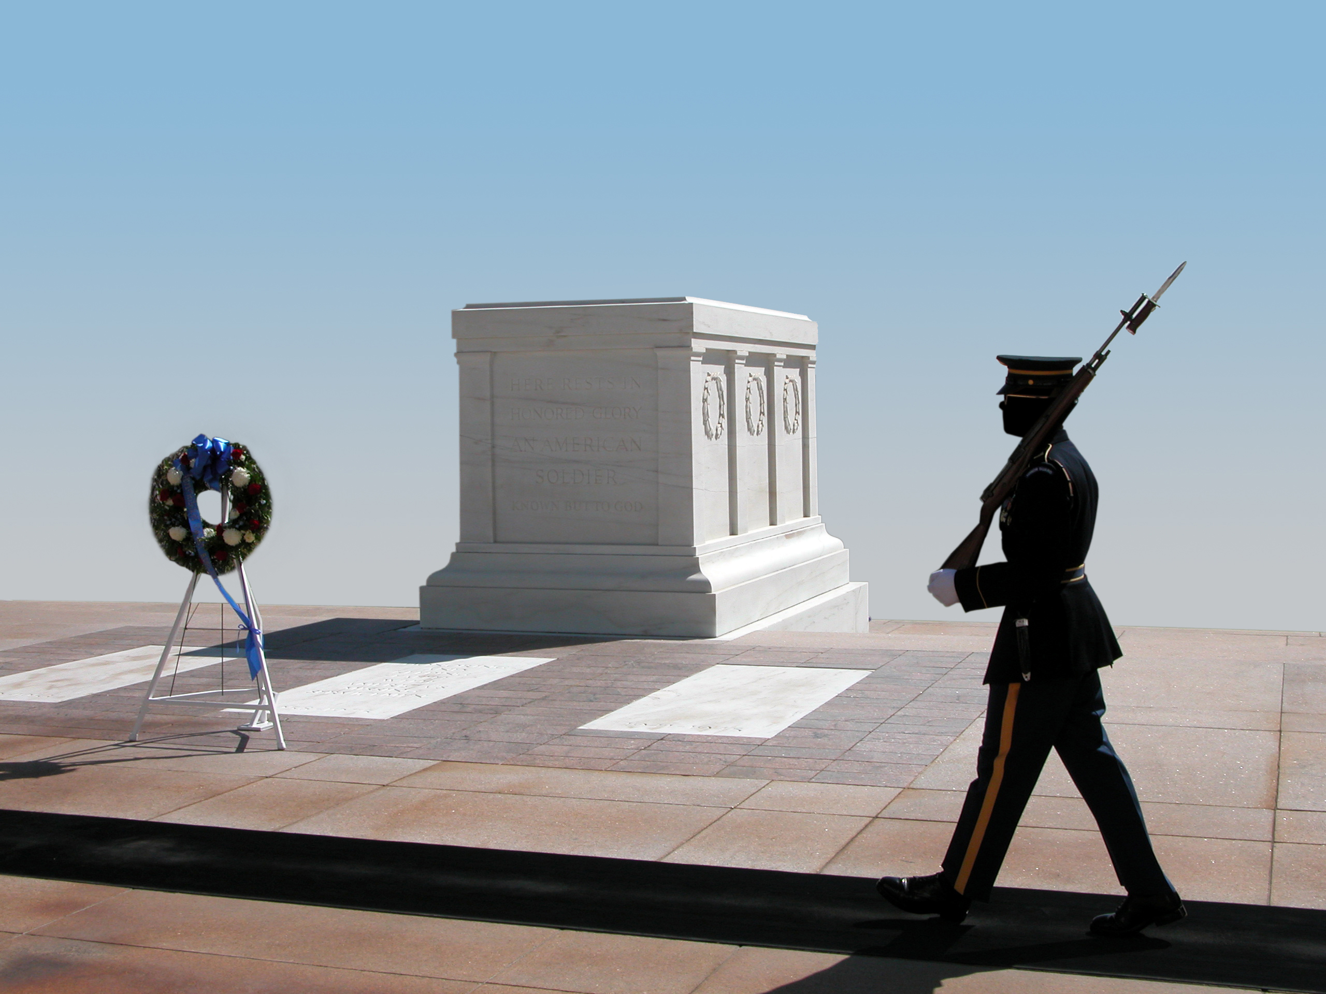
Mid-Year Achievements for 2025 -2026
15 Midyear reports
Five members gathered for the 9/11 flag lowering
Flag ribbons passed out
Americanism Essay information provided to grandchildren of Legionnaires, Auxiliary, Sons, and Riders
The essay contest was introduced at elementary, middle, and high schools; public, private, and home schools.

Slide 3
Mid-Year Achievements for 2025 -2026
Flags posted at cemeteries
Donations presented to Junior Shooting and baseball
One member worked as a voting poll member, and the entire unit came together to vote
Volunteer Hours 157.50 x 35.45= $5583
Donations $40
Monetary In-Kind Donations $260
Miles driven. (.14 cents per mile) None reported (According to the IRS, the rate is 14 cents per mile for charitable purposes and 21 cents per mile for medical transportation or military moving. This is important for the Year-End Reporting results.)
Together Everyone Achieves More!

Slide 4
Moving Forward: Prepare for America’s 250th Birthday American Legion Family Day
I’m sure a few Auxiliary Units have started to plan for their celebration of America’s 250th birthday. When we prepare for this, let’s plan it like it’s a “WEDDING!”
We also have the “Family Event” to participate in the American Legion Family Day, the last Saturday in April.
Think out of the box! Combine with your Post and even other units. Remember to capture action picture shots.

Slide 5
Upcoming 2026 Americanism Contest “Celebrating America’s 250th Birthday and the Veterans who fought for our Freedom”
Due Dates:
By February 28, 2026, all completed essays need to be returned to your unit for judging purposes.
A team of three people can review, judge, and pick one winner from each category.
All chosen essays are required to be sent to me by March 14, 2026, by 11:59 PM EST.
A team of three people will review each category, and the best one from each category will be forwarded to the Divisional Chair by April 15, 2026.
The results will be announced at the National Convention.
Unit TEAMWORK makes the dream work!
T-together E- Everyone A- Achieves M- More!

