Slide 1



Children and Youth 2025-2026
“Mission Driven, Family Focused, Nurturing Youth in Our Communities”
The Children & Youth Program emphasizes protecting, caring for, and supporting children and youth, particularly those of veterans’ and military families.
Chair Vice Chair Advisor Karen Hunter Beverly Pollard Dr. Lisa Chaplin khiteach@aol.com Bpollard1096@gmail.com lisachaplin@lexacom.net 703-314-6294 703-946-5960 804-641-1400

Slide 2


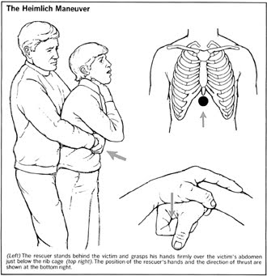

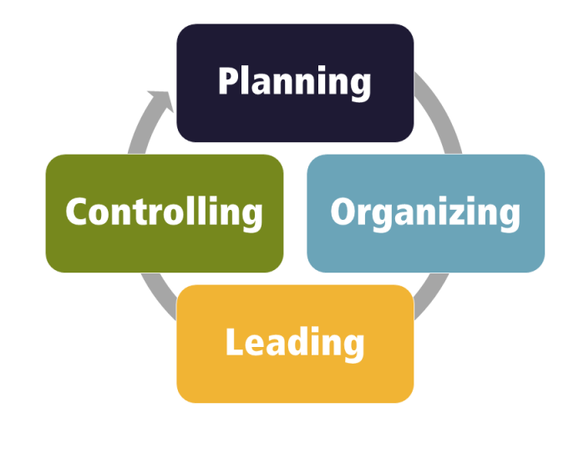

Recognize and reward the positive actions of our children and youth, the American Legion Auxiliary has two special national awards bestowed to youth nominated by Units.
The “Good Deed Award” recognizes a youth who donates time and/or money for a worthy cause. They demonstrate leadership in community service by planning, organizing, and executing a service project.
The “Youth Hero Award” recognizes a youth who demonstrates a physical act of valor and is an inspirational role model for the organization and the community.
Be on the look-out for worthy candidates throughout the year!
Submit your nominations at https://www.legion-aux.org/youth-hero-good-deed-awards anytime throughout the year.
Please remember to send me a copy of your nominations.
This Photo by Unknown Author is licensed under CC BY-SA-NC

Slide 3

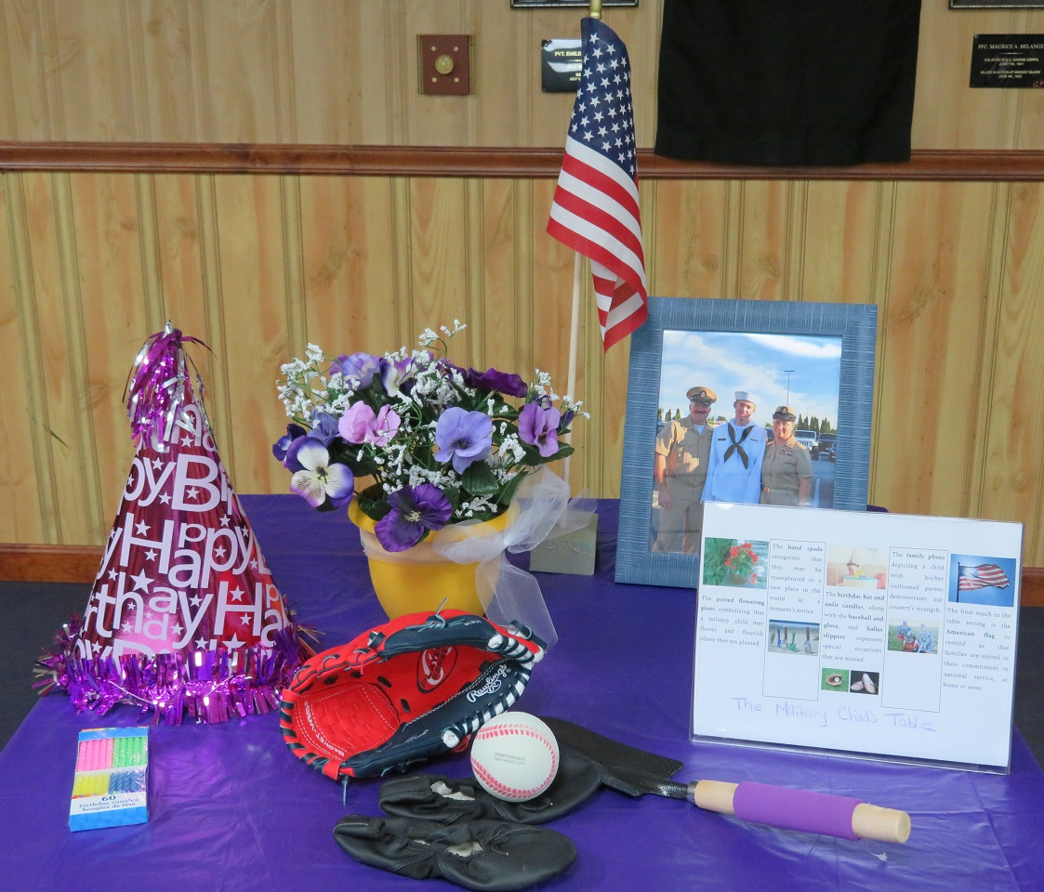


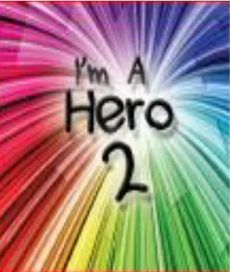
Participate in Month of the Military Child in APRIL.
“Military Child Table Ceremony”
“Month of Military
Child Proclamation”
“Kids of Deployed are Heroes 2 Stickers”
An ALA initiative honoring military children who may be experiencing separation from one or both parents
on April 15th

Slide 4

Contribute to The Child Well-Being Foundation (CWF).
The American Legion Auxiliary Children & Youth Program strives “to educate members and the general public about the Child Well-Being Foundation (CWF), its mission, and to provide financial assistance to The American Legion in their efforts to award grants to youth-serving nonprofit organizations.” A Key Program Statement from National Children & Youth Get Involved—Liaison to Child Well-Being Foundation.
Consider participation in the “100% per Capita Banner Program”.
A form can be downloaded at https://www.cwf-inc.org/ , printed, and mailed in with your Unit’s donation to American Legion Child Well-Being Foundation (CWF) in Indianapolis, Indiana before May 31, 2026. Upon receipt, Units making donations of at least $1.00 per member will receive a nice CWF streamer for your Unit.
Past National President, Trish Ward, has a goal to receive donations for the Child Well-Being Foundation(CWF) from all Departments in 2025-2026.
Let’s help National have a “Banner Year for CWF!"
Please pay your “Children & Youth” and “ALL” ROAR citations.

Slide 5


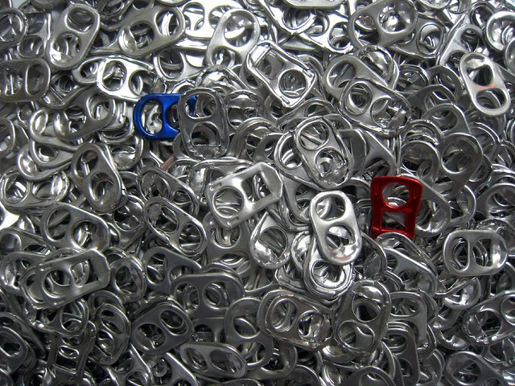



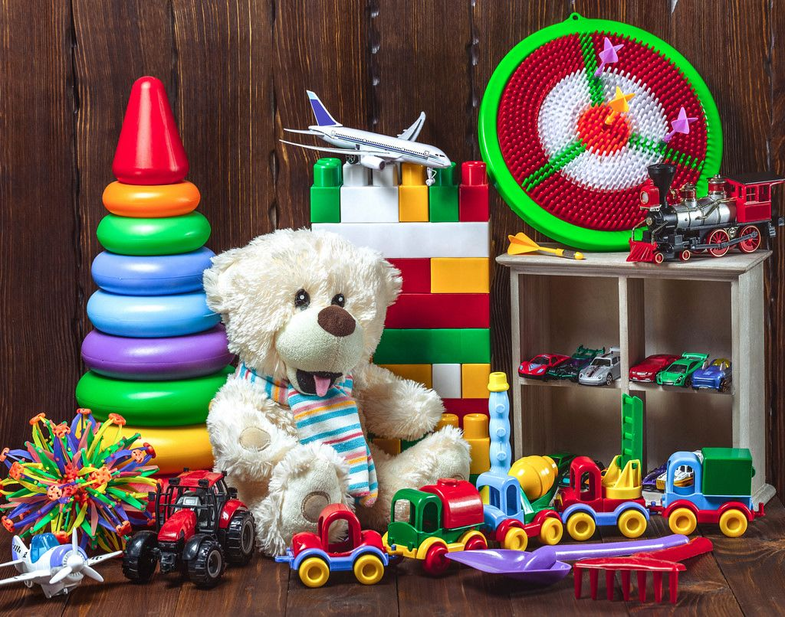
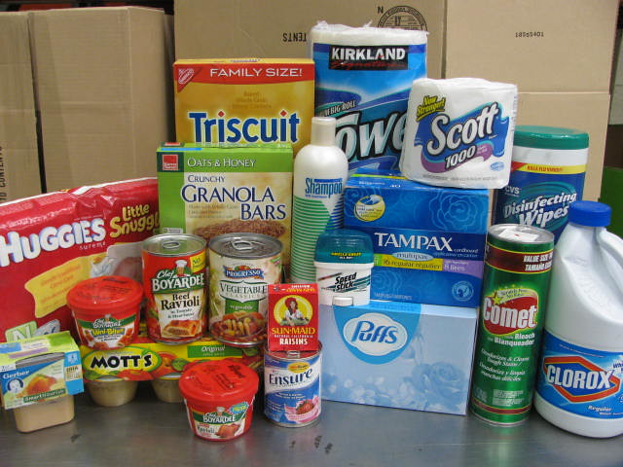
Our Children & Youth Special Project for 2025-2026
Ronald McDonald Houses serve “both” military children and non-military children as well as their families.
There are 5 Ronald McDonald House locations throughout the state of Virginia. They are in Fairfax, Richmond, Charlottesville, Roanoke, and Norfolk.
Please consider donating to this worthy cause and the children of Virginia!
Monetary donations can be made to ALA Dept. of VA with C&Y Special Project on the memo line.
There are also In-Kind service projects or donations your Units can do with Ronald McDonald Houses in your vicinity to make a difference for Virginia’s youth!

