Slide 1
ALA Community Service 2025/2026 Mid-Year Summary
CHAIR: Jane Ruehrwein
VICE CHAIR: Sue Rarick
Advisor: Cheryl Shine - PDP

Slide 2
Report Overview
• 33 units participated
• 206 members volunteered
• 6,051 total volunteer hours
• $12,342 in donations
• $43,528 spent supporting communities

Slide 3
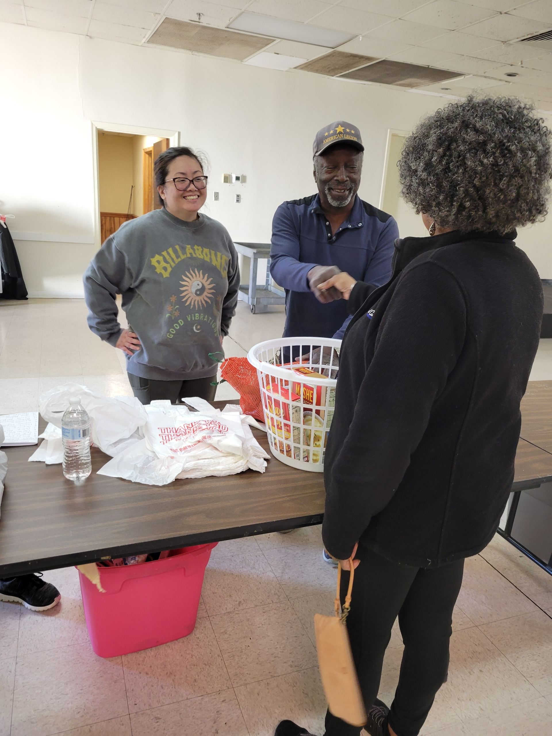
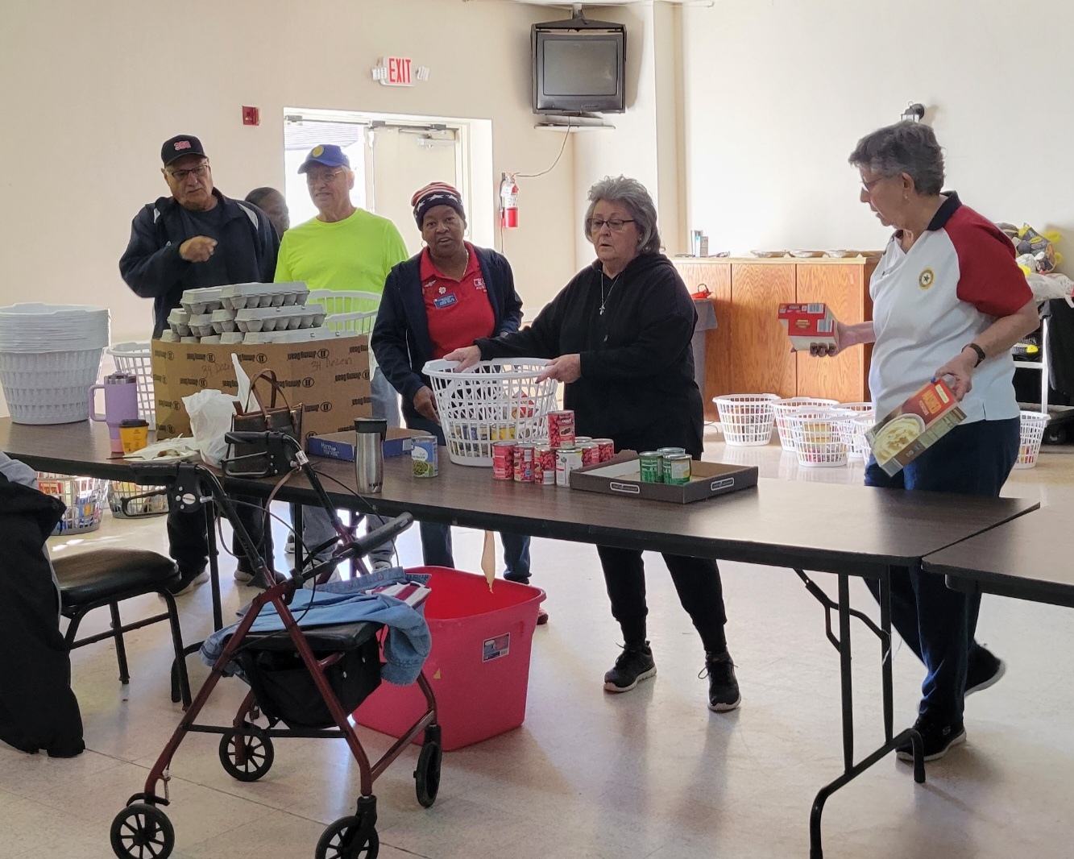
Community Impact
This report reflects the outstanding dedication and compassion of our units.
Their efforts significantly improved the lives of local communities.

Slide 4
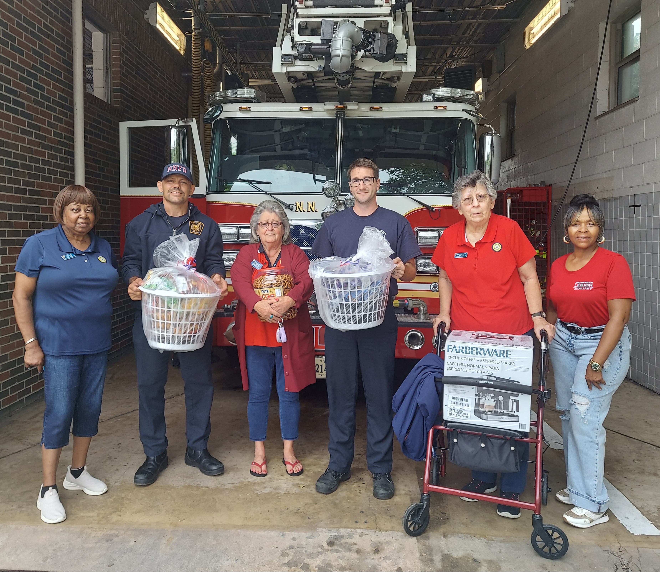
Community Service Activities (1/2)
• 9/11 National Day of Service
• Homeless shelters
• Food for needy families
• Senior programs
• Animal shelters
• Breast cancer awareness events

Slide 5
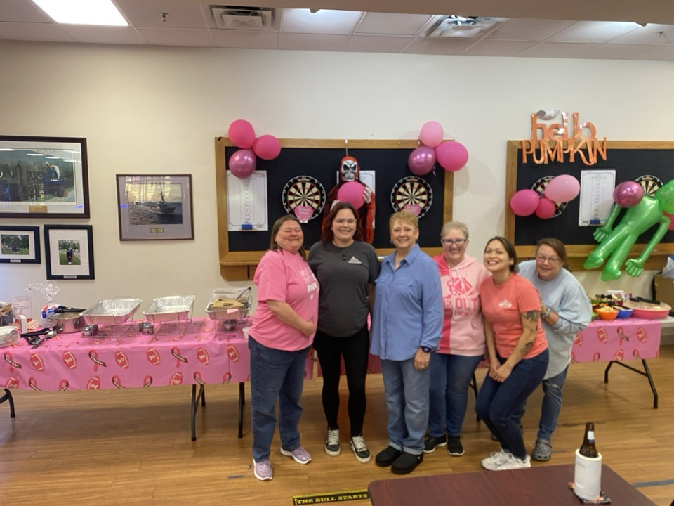
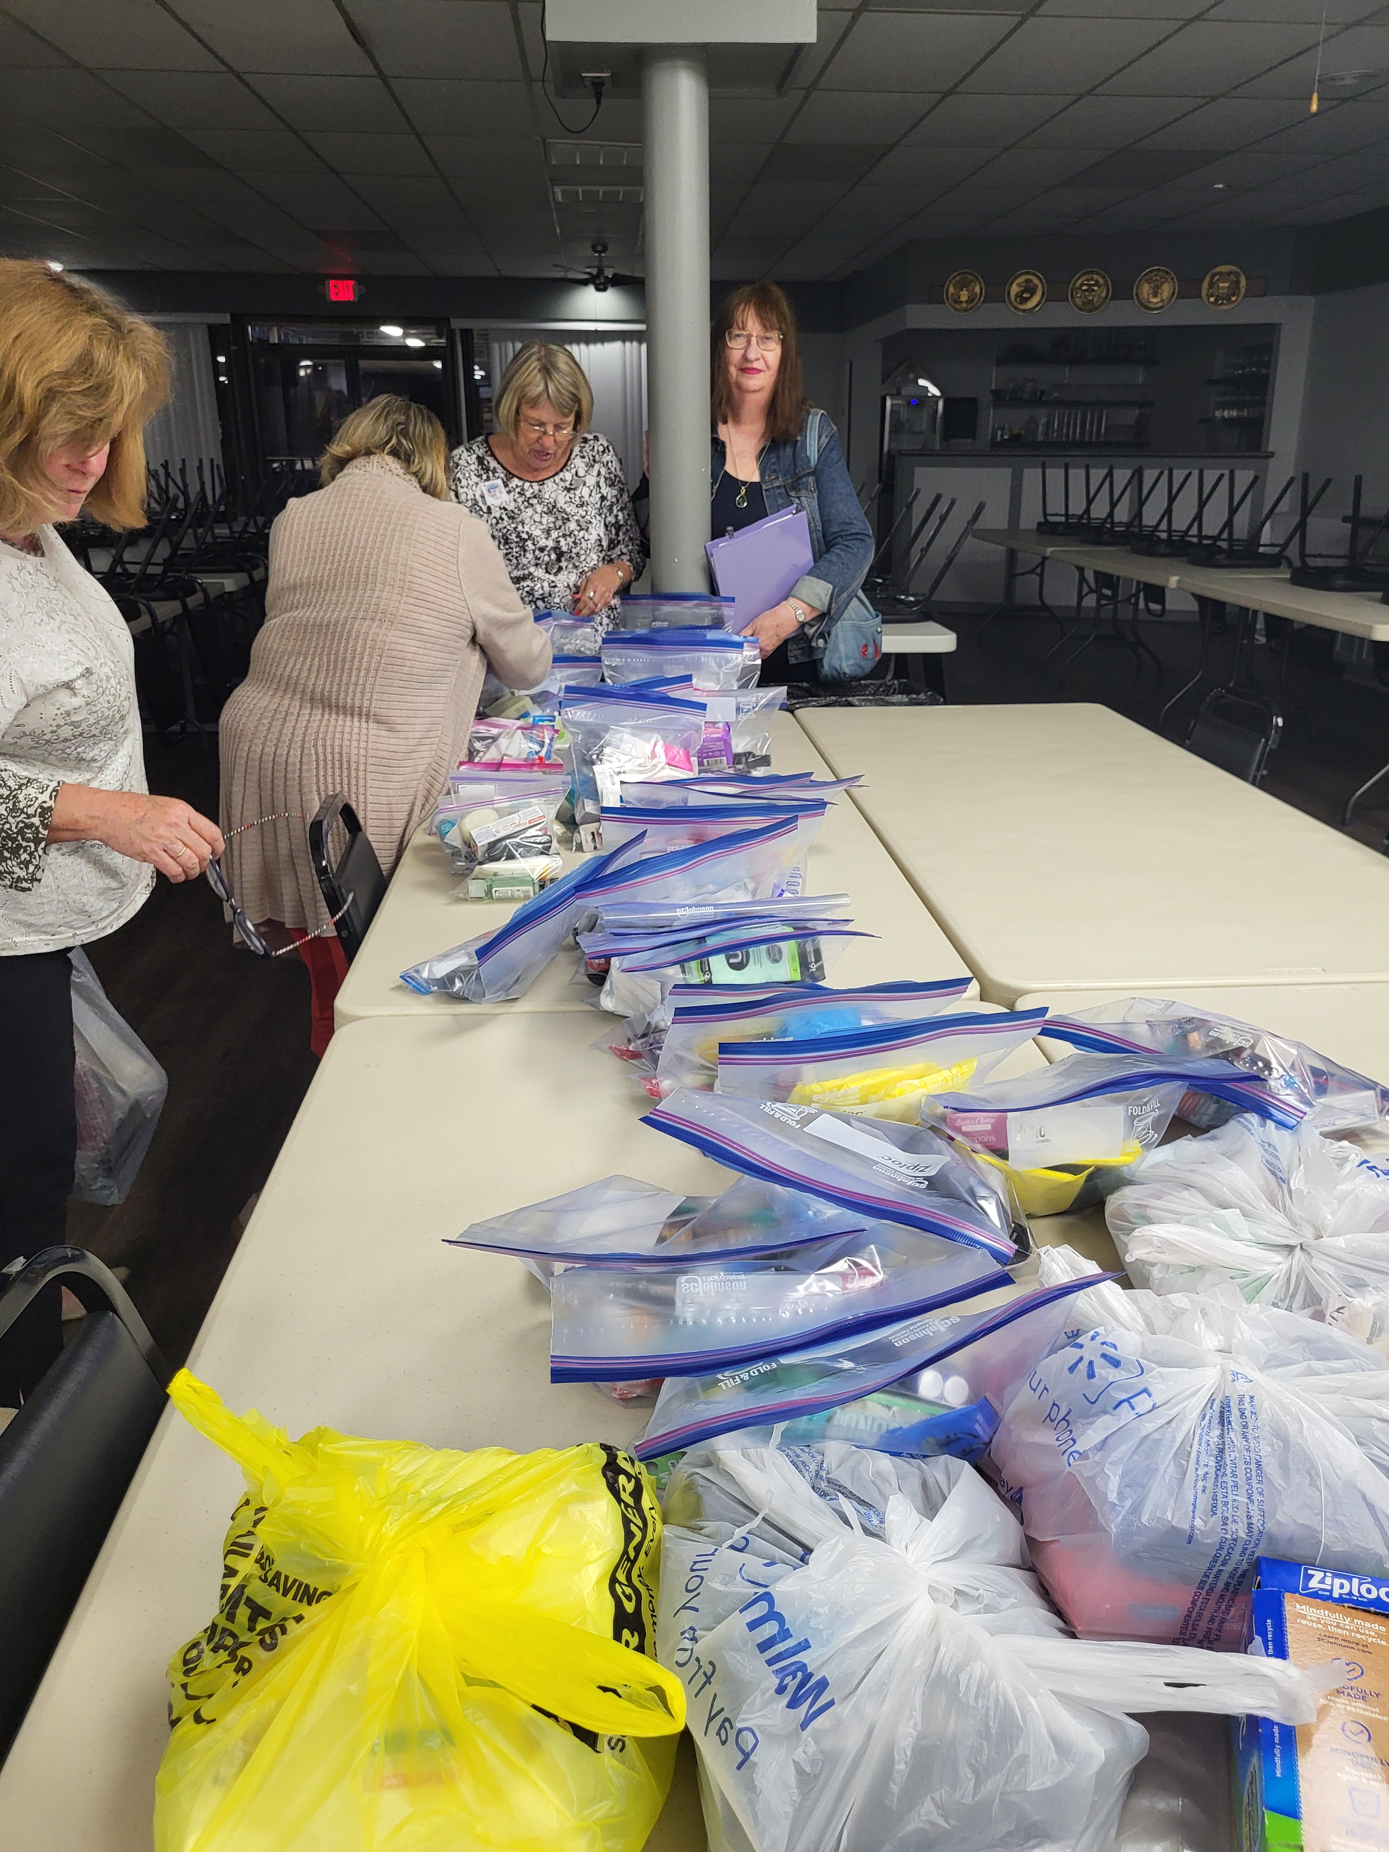
Community Service Activities (2/2)
• Local churches
• Mammogram bus
• Red Cross blood drive
• War on Fentanyl events
• Flag donations
• Food banks
• Community breakfasts

Slide 6
Closing Message
These efforts show what can be achieved when people take time out of their busy lives to help others.
*Reminder, the End of Year Reports are
due April 15, 2026
Jane Ruehrwein
For God and Country

