Slide 1
American Legion Auxiliary Virginia Girl State
2025-2026
Chair - Cheryl Shine
Vice Chair - Pamela Elam-Lipscomb
Advisor - Margaret Dellinger

Slide 2
REMINDER DEADLINE DATES
*April 15, 2026 – All delegate fees received by the district registrars May 1, 2026 – Last day to request a refund May 15, 2026 – All delegates must be registered June 1, 2026 – Online forms completed [follow up with your delegate(s) to ensure they have received and completed the online forms]

Slide 3
Be A Girls State Angel
donate on www.vgirlsstate.org
Thank You cards
for Honor Flight Mail Call

Slide 4

Service Driven With Future Focus
Consider being a Counselor

Slide 5
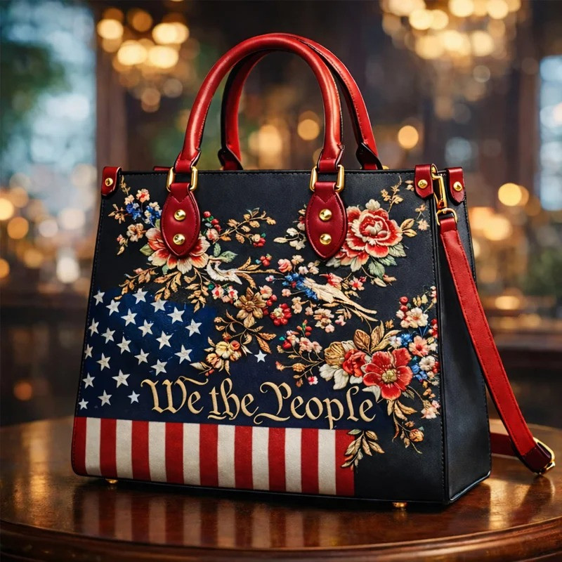
Girls State Fundraiser at Convention
250th Anniversary
“WE the People”
Handbag

Slide 6
Reminder:
Annual Report Date
Due by April 15, 2026
should reflect your unit activity from April 1, 2025–March 31, 2026.

