Slide 1

LEGISLATIVE PROGRAM
2025 -2026
“A Voice for our Veterans, Military and Their Families”
Susan “Sue” Oertel Pamela Elam-Lipscombe, PDP
Chair Advisor

Slide 2
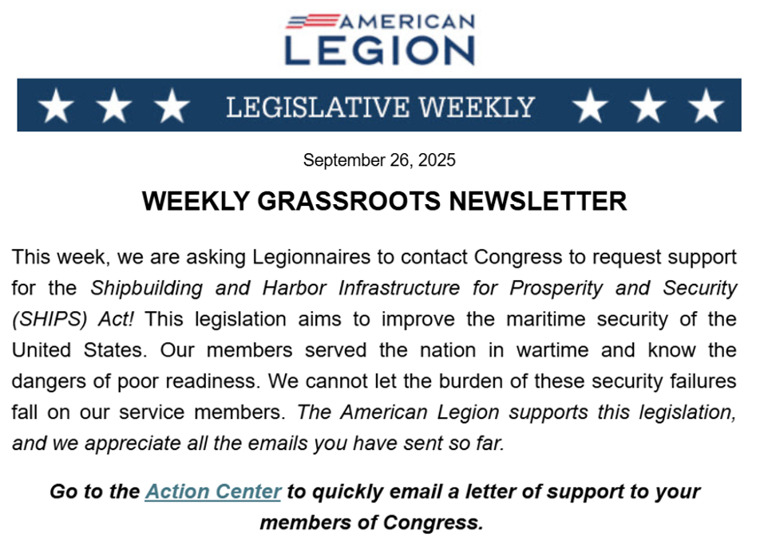
MEMBERS SIGNED UP FOR THE WEEKLY GRASSROOTS NEWSLETTERS
Nationwide in 2025
American Legion Family members and veteran advocates used the Grassroots Action Center sending:
102,873 messages
to Congress urging them to pass Legion-supported legislation.

Slide 3
A VOICE FOR OUR VETERANS, MILITARY AND THEIR FAMILIES
MID – YEAR REPORTING
Department of Virginia ALA members persevered by contacting their senators, congressmen, state legislators, and local representatives for a total of 450 times as of December 1st. Contacts were also made to the White House.
During the government shutdown, many members reported not receiving responses back from legislators’ offices.

Slide 4
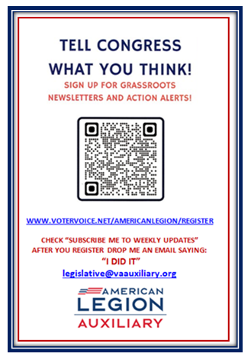
“Way to go Department of Virginia”
The use of the QR code to sign up for Grassroots Action Alerts appeared to be successful. Not only was it given out at our Fall and District conferences, it was also given to Legionnaires and SONS. So, with the combined efforts of the Legion family…
The Department placed #6 and #7 NATIONWIDE for the month of December in sending Action Alerts to our members of Congress!

Slide 5
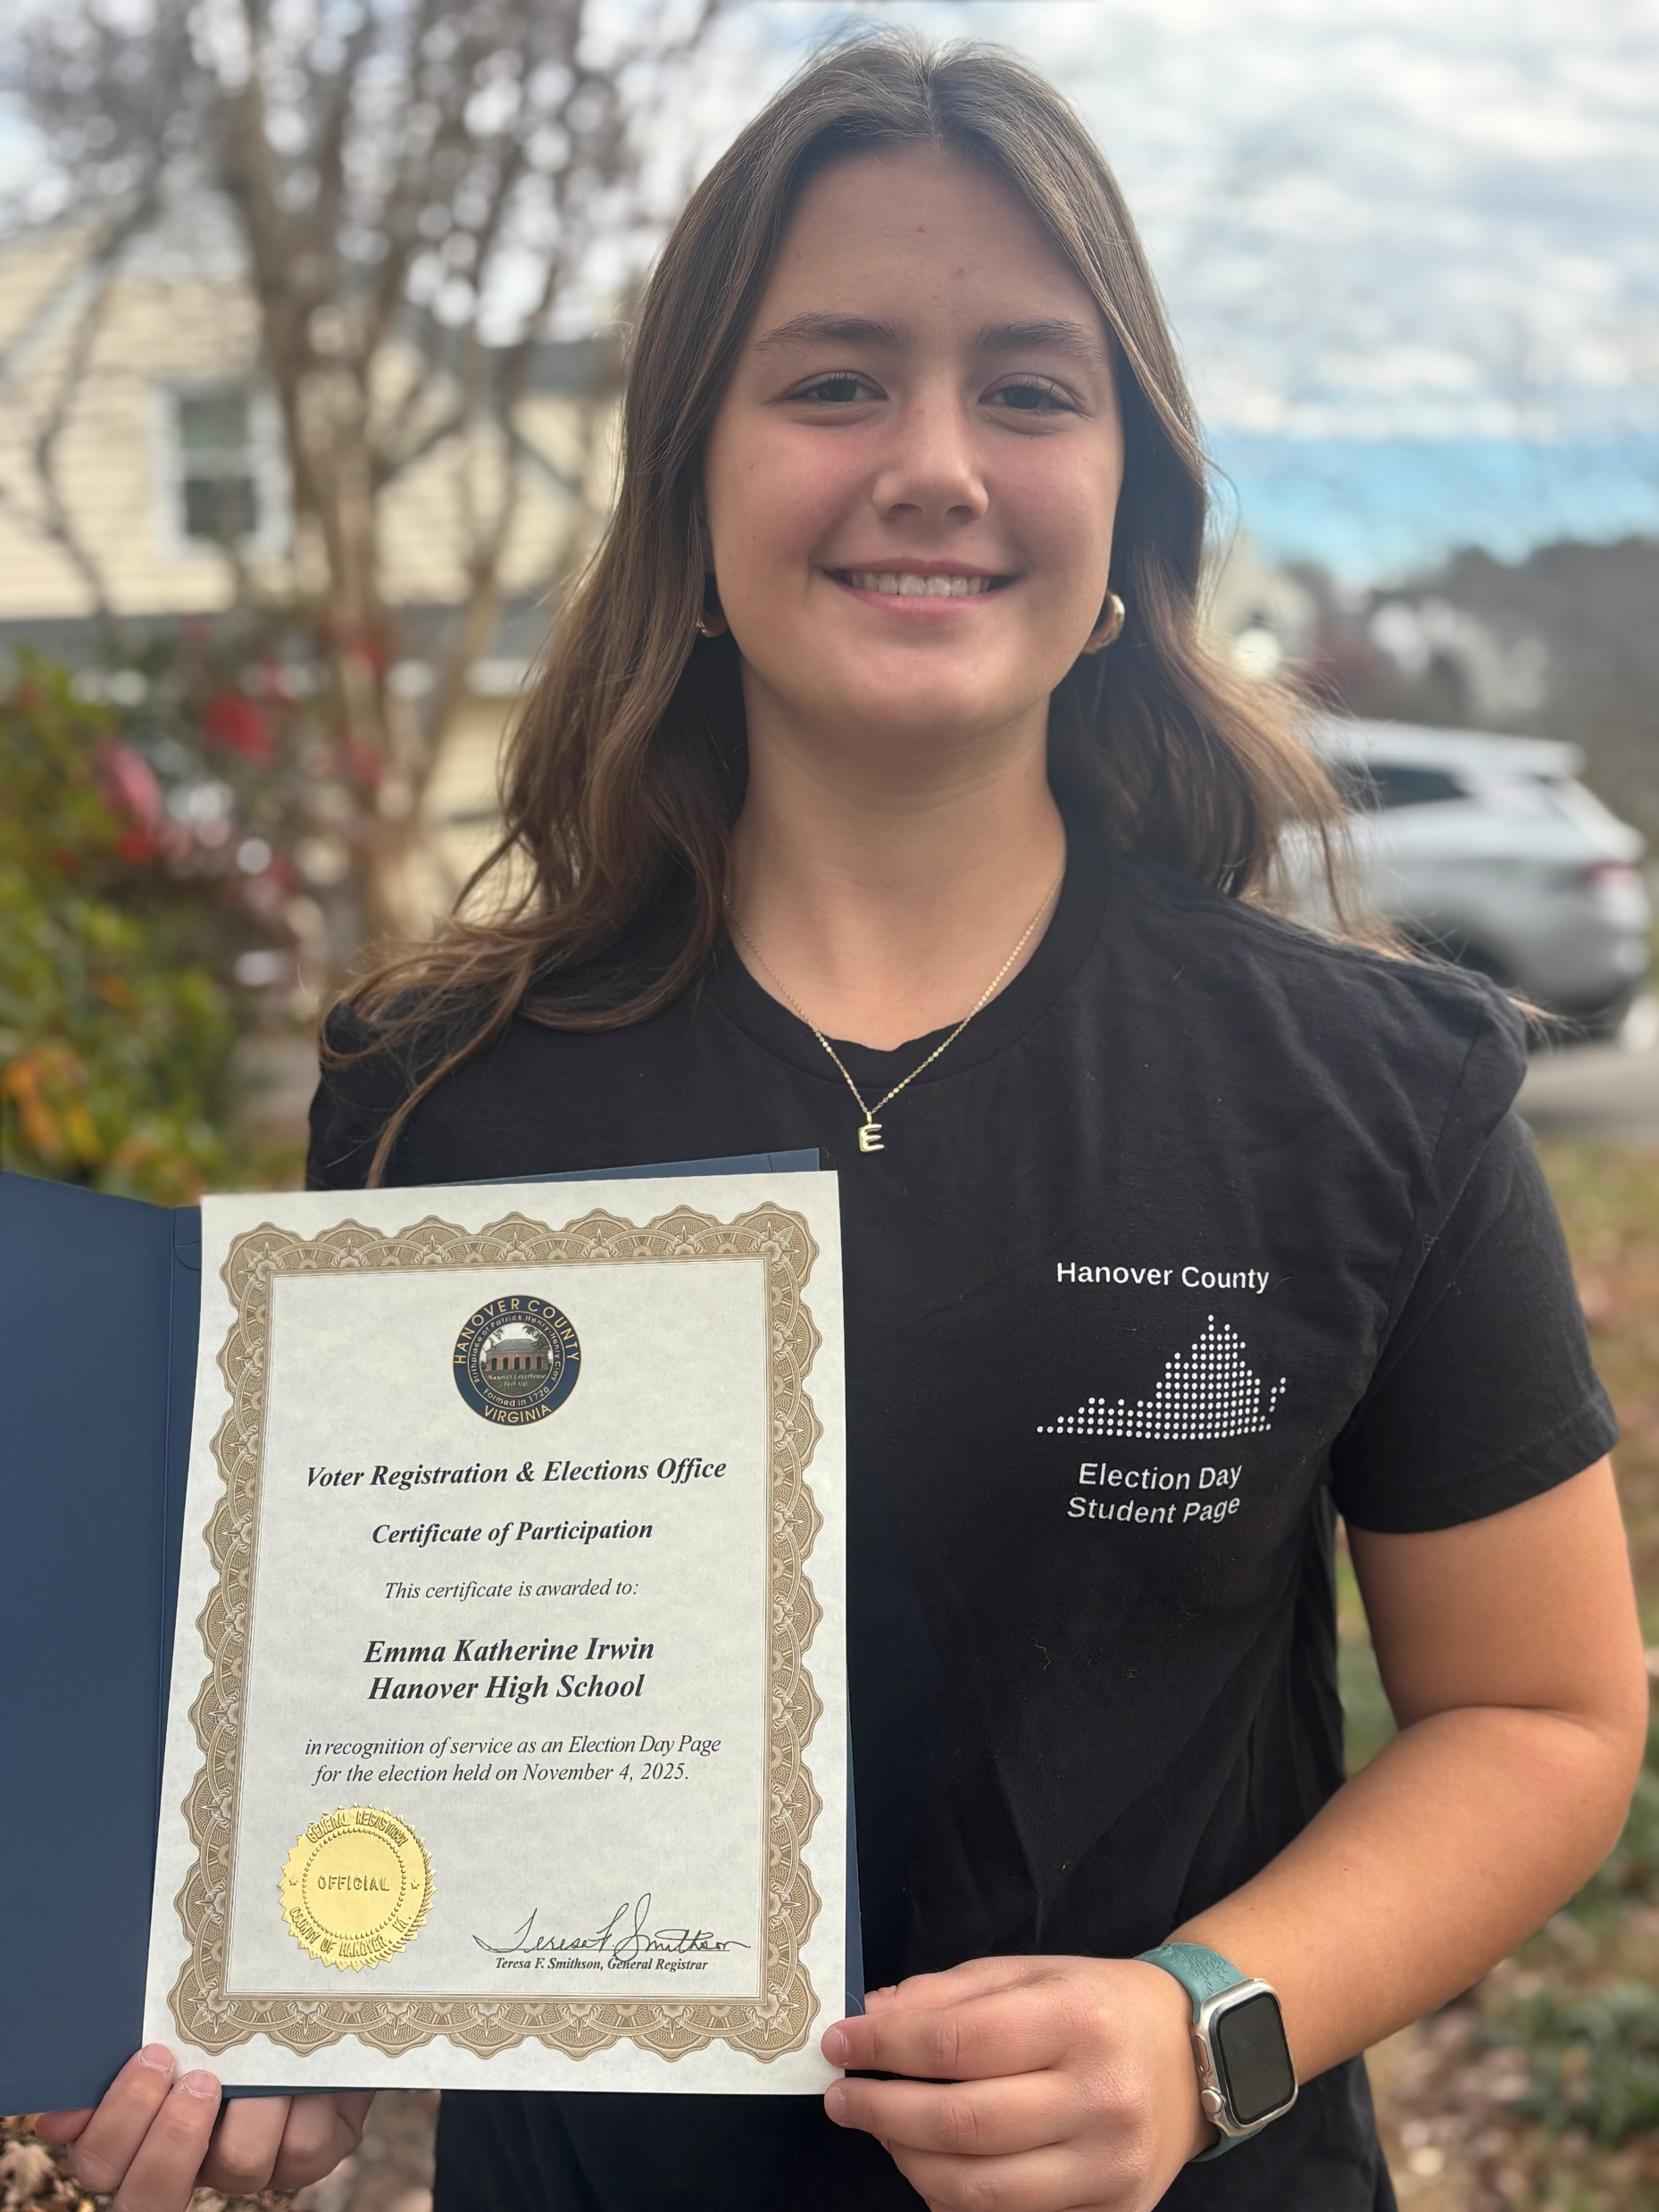


LEARNING THE LEGISLATIVE PROCESS
JUNIORS
They may not be able to vote yet, but you can encourage your Juniors to get involved in the Legislative process by working the polls as a greeter during Election Day or attending Virginia Girls State.
EMMA KATE
ALA UNIT 284 Junior
Election Day Greeter

Slide 6
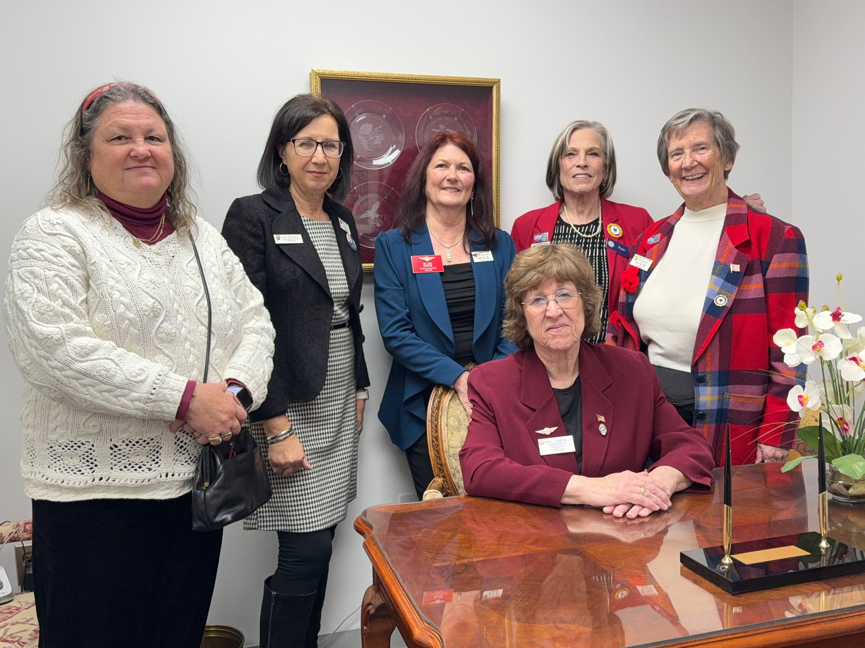
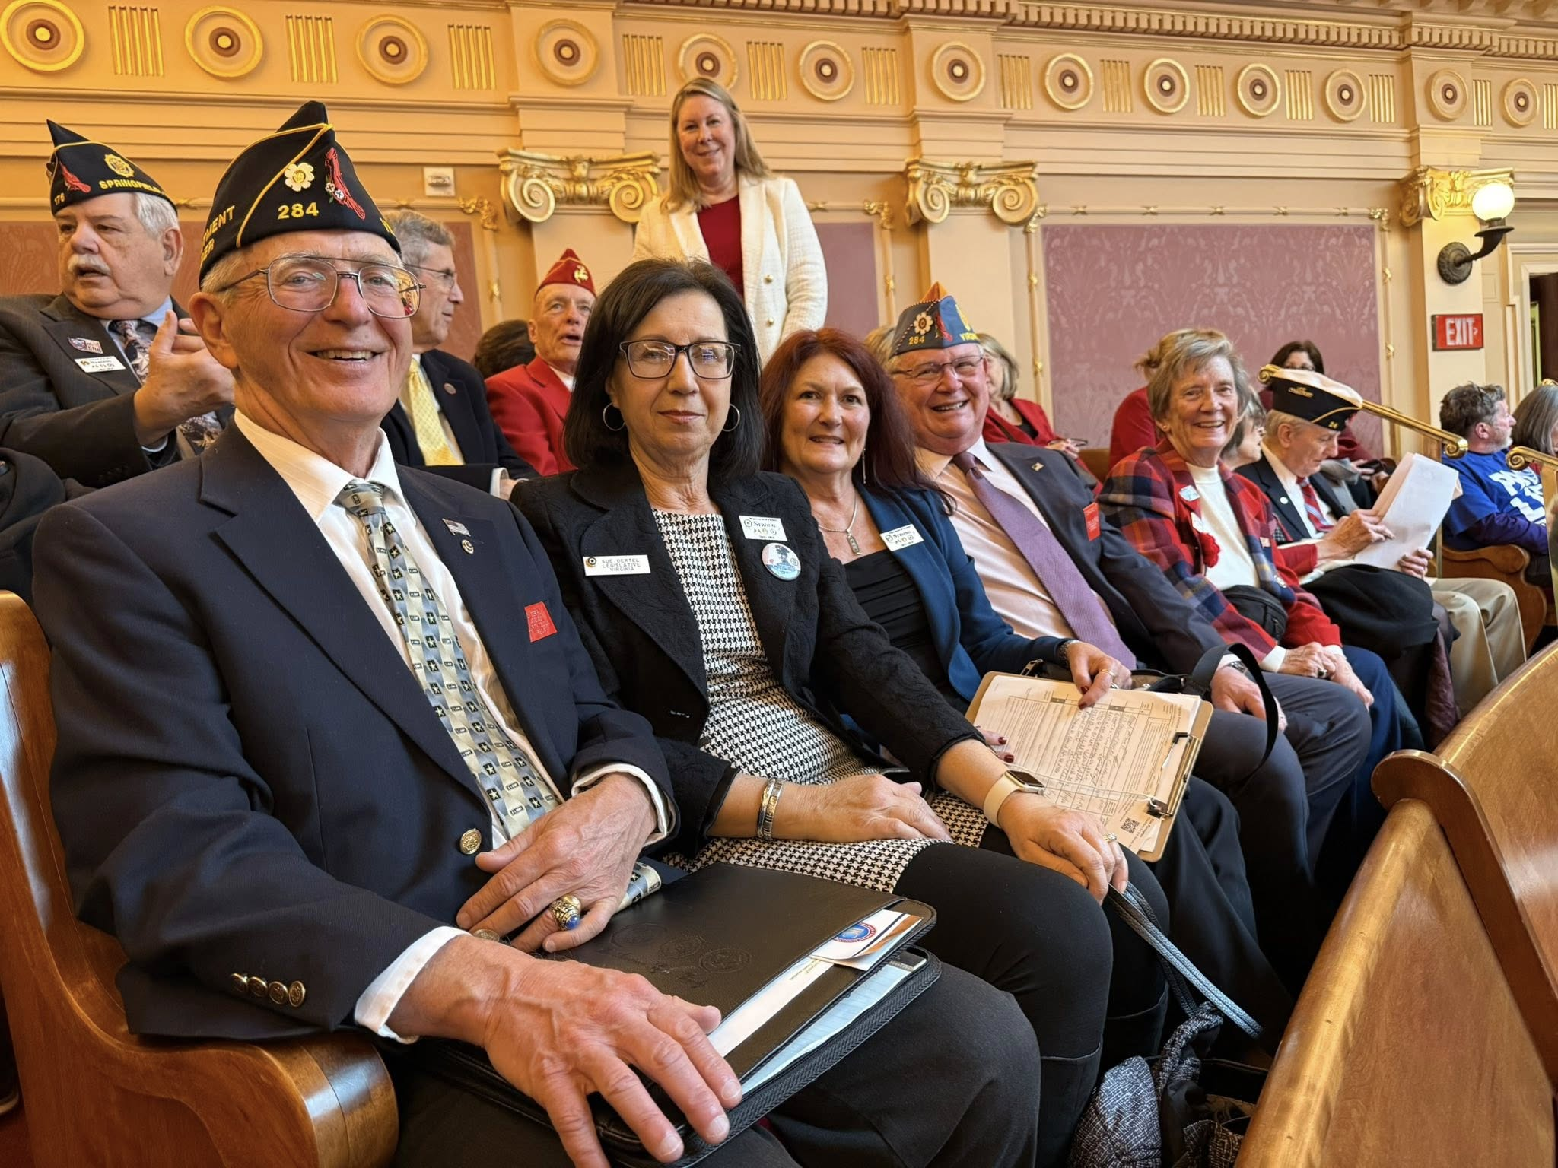
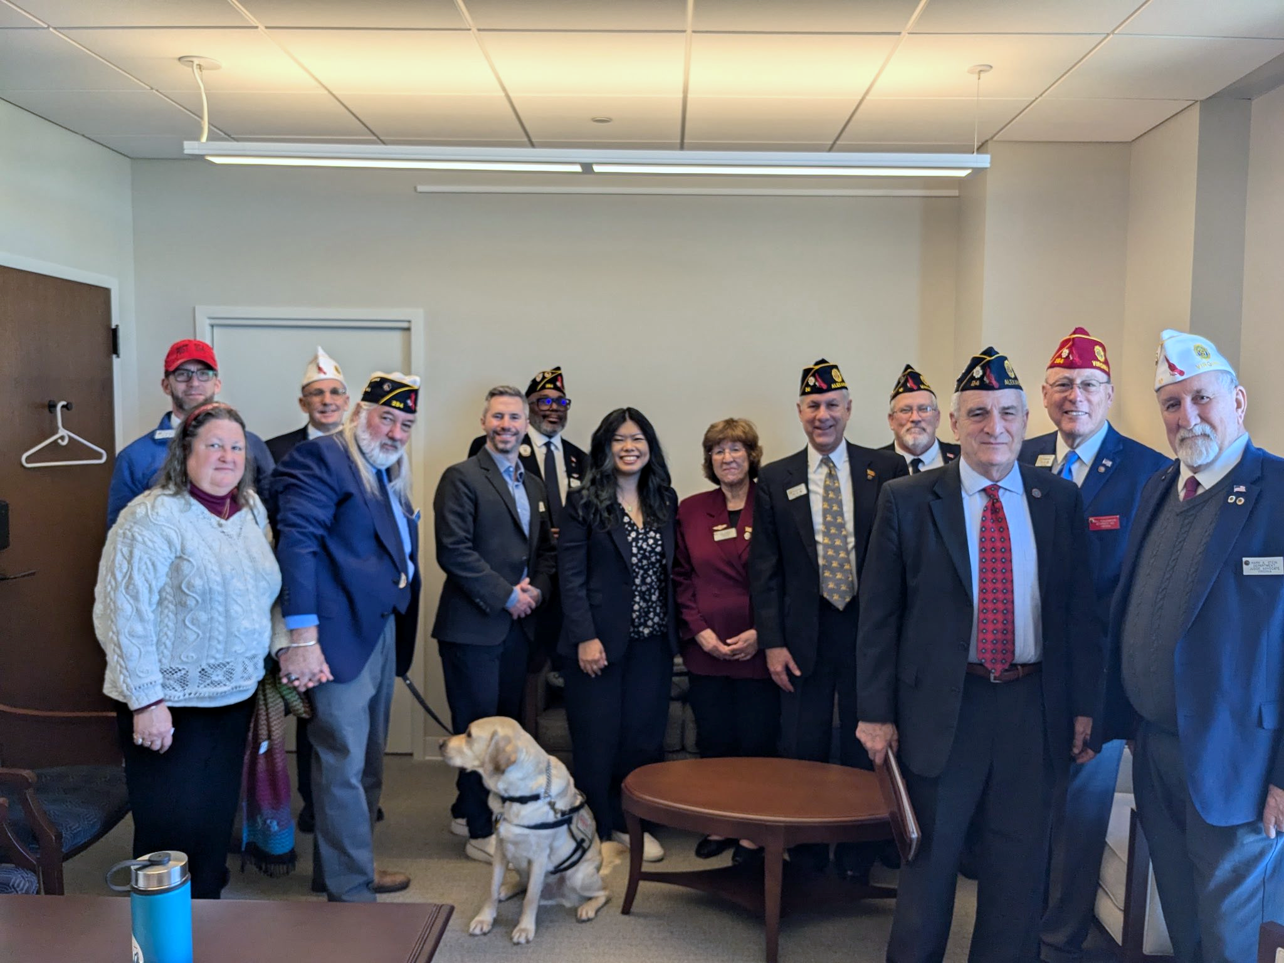
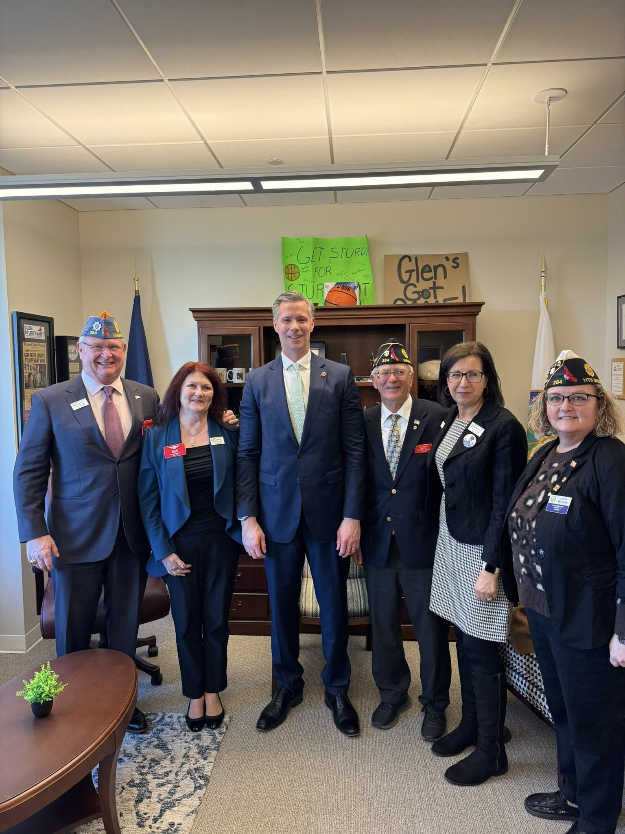
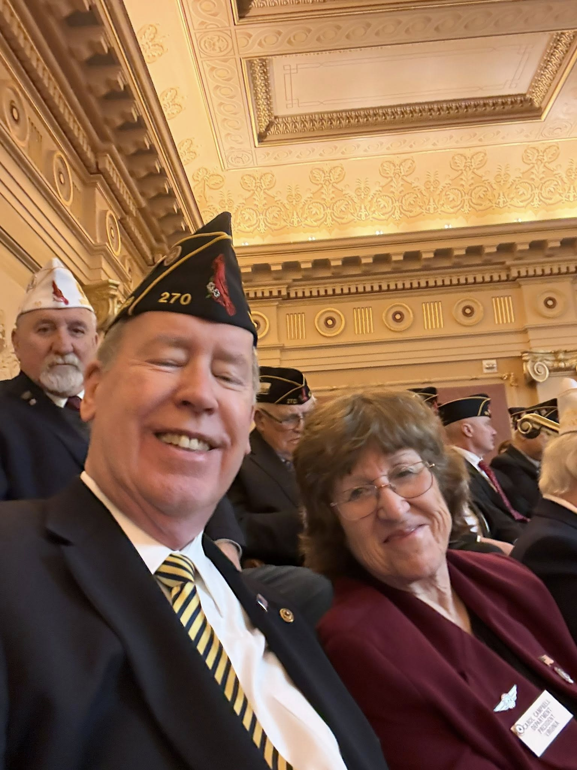
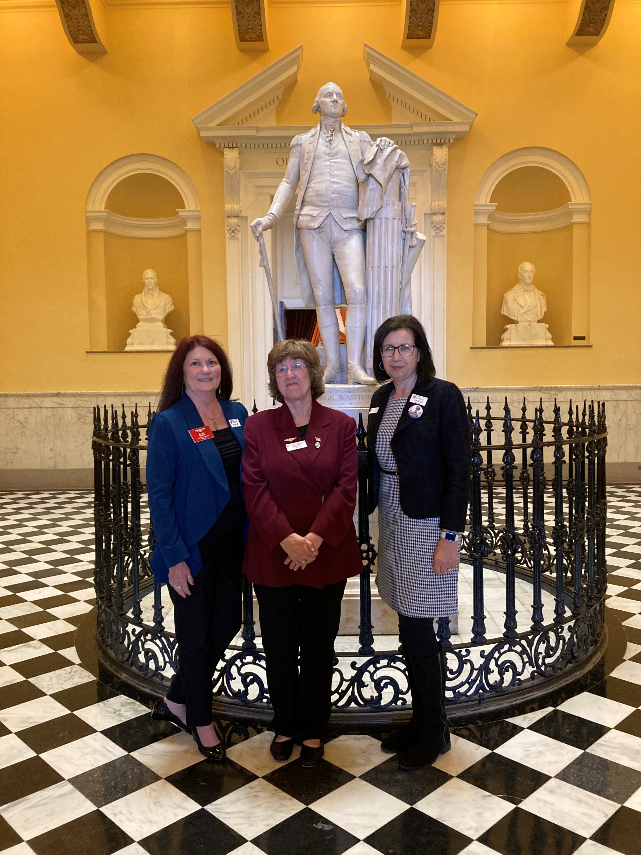
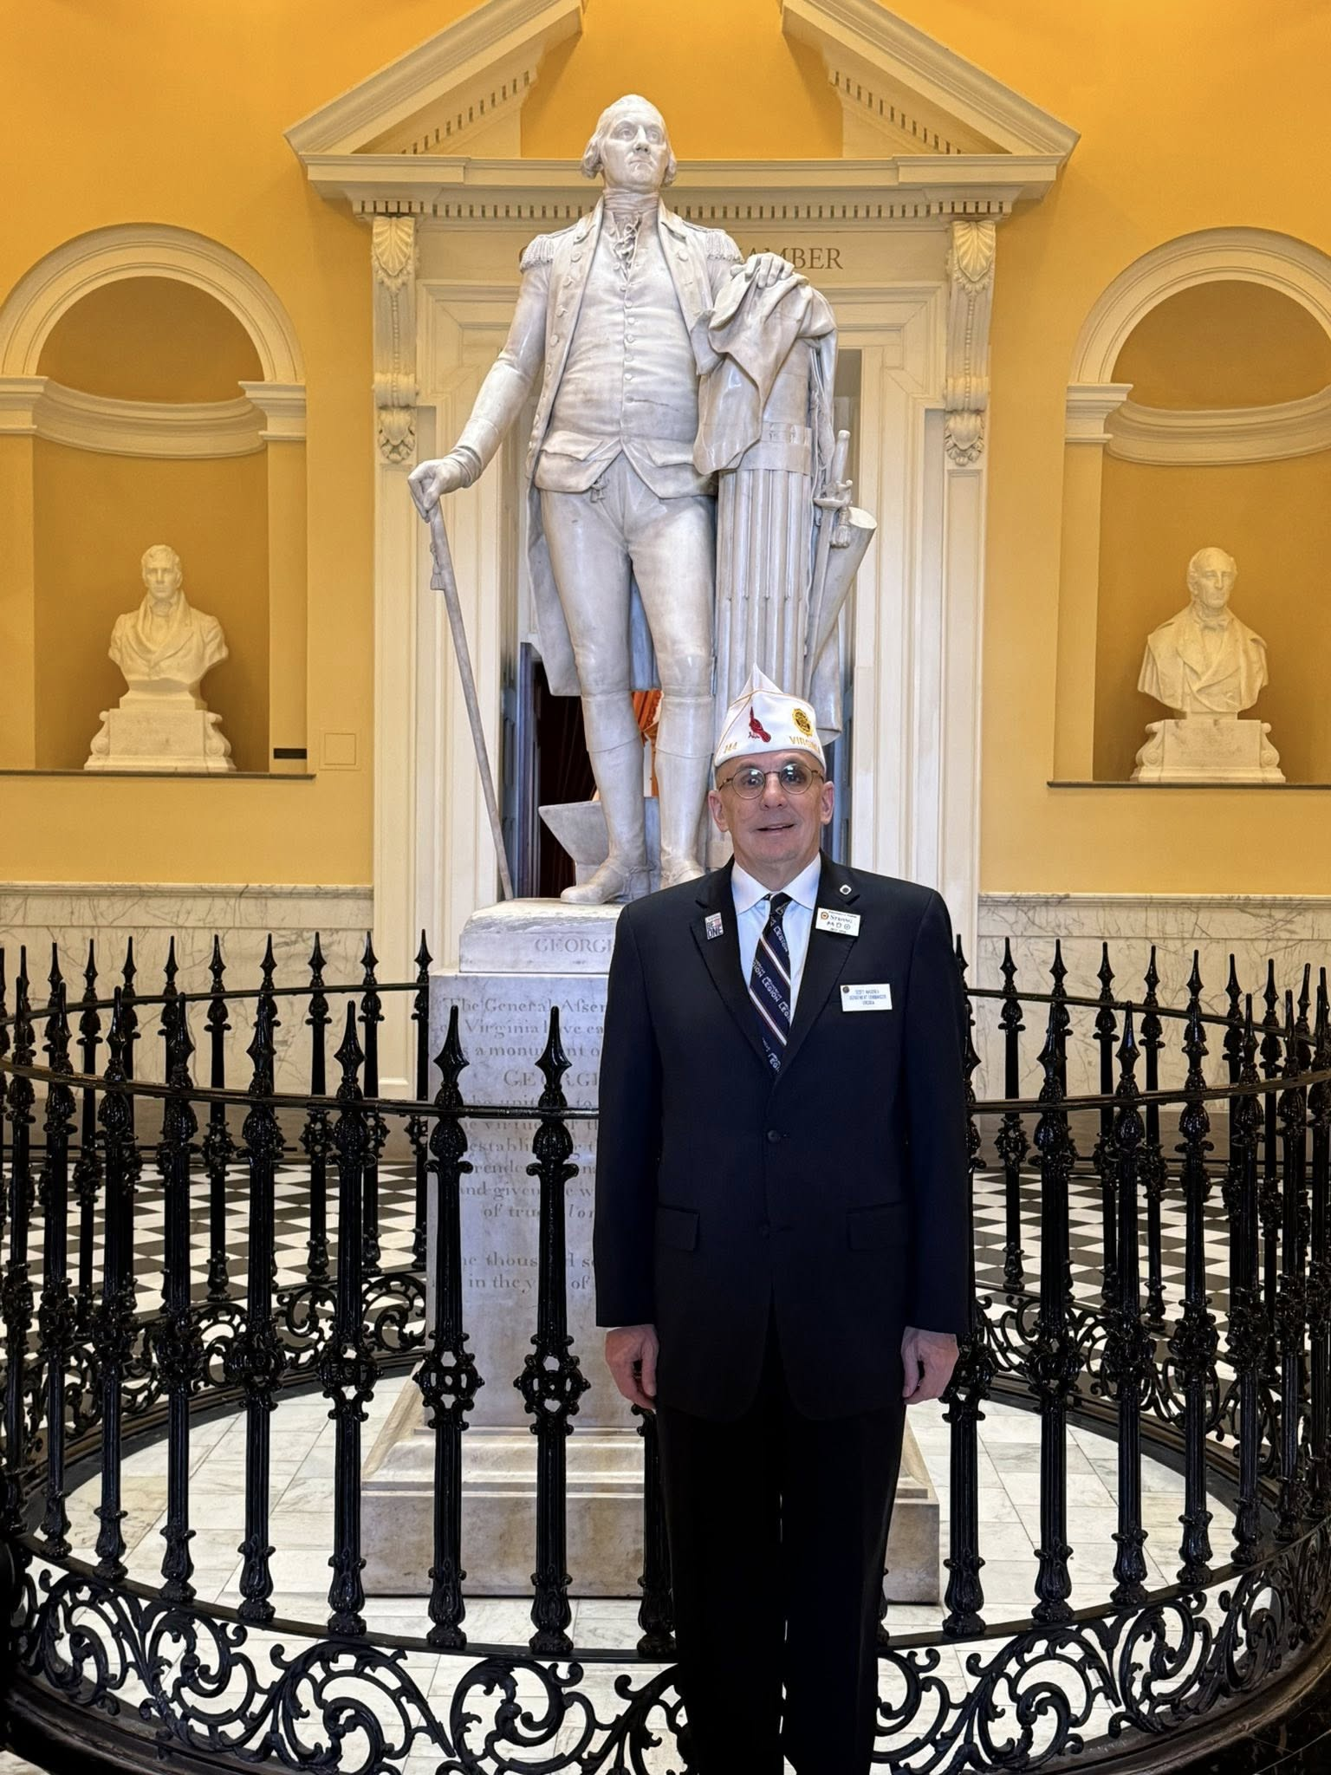
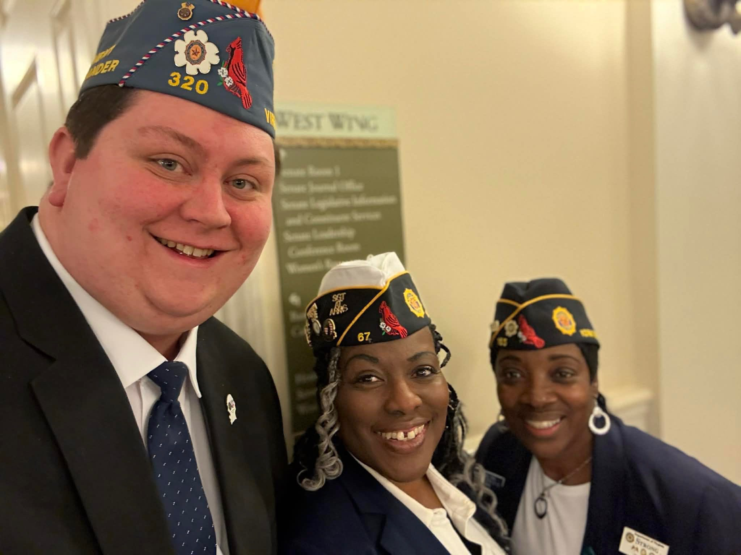
The Legion Family
DAY ON THE HILL
Senate visit
Madam President visiting her office

Slide 7

Washington DC Conference
Department of Virginia
Auxiliary members to attend and meet with members of Congress
Continue to review these Priorities and be knowledgeable about them when responding to Legislative Action Alerts and when speaking with Legislators concerning upcoming Agenda items. This insures you are well prepared for advocacy efforts.
Talk with Legislators and give them information that will encourage them to support The Legion Legislative Priorities.
These are the top-level issues The American Legion will be working with Congress to enact:
• Suicide prevention
• Community care
• Compensation and Pension (C&P) examinations
• Improve care for Women Veterans
• Guard & Reserve GI Bill Parity
• Major Richard Star Act
• End veteran homelessness
2nd Session
available soon on the
Legion website

Slide 8

PLEASE CONTINUE TO:
Keep track of contacts with your State & National Legislators via letters, emails, and phone calls
Sign up for the ALA Legislative Committee Facebook Page
Review & distribute ALA Legislative Advocacy Guide
Sign up for Grassroots Action Center Alerts and Legislative Updates
Take pictures and include the JPEG version with your report
End of Year Reports are due April 15, 2026

