Slide 1
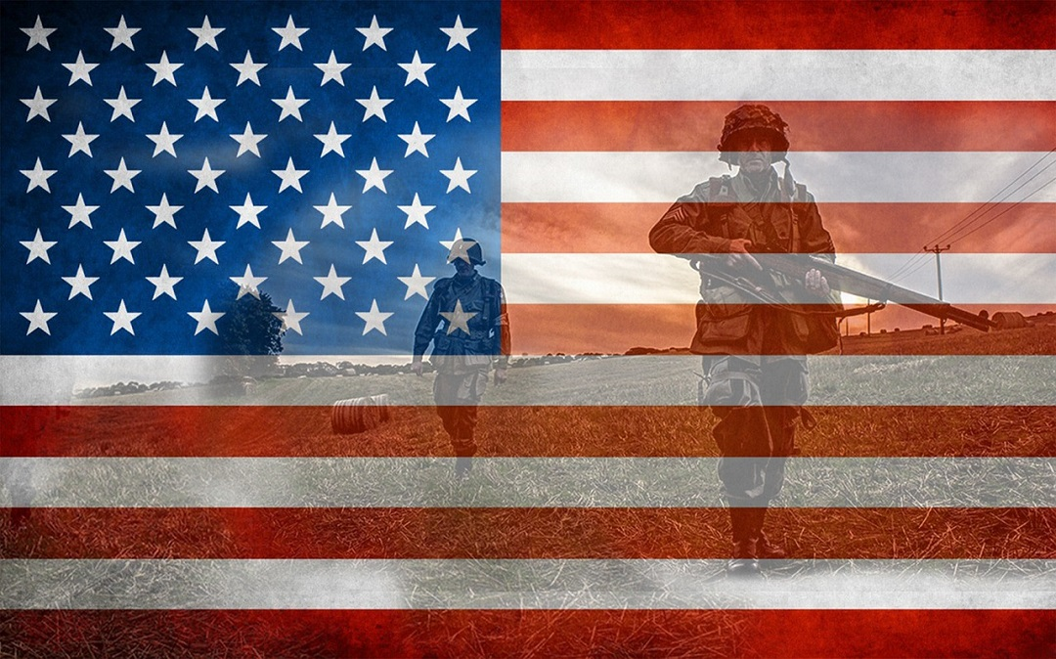
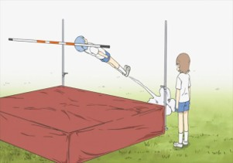
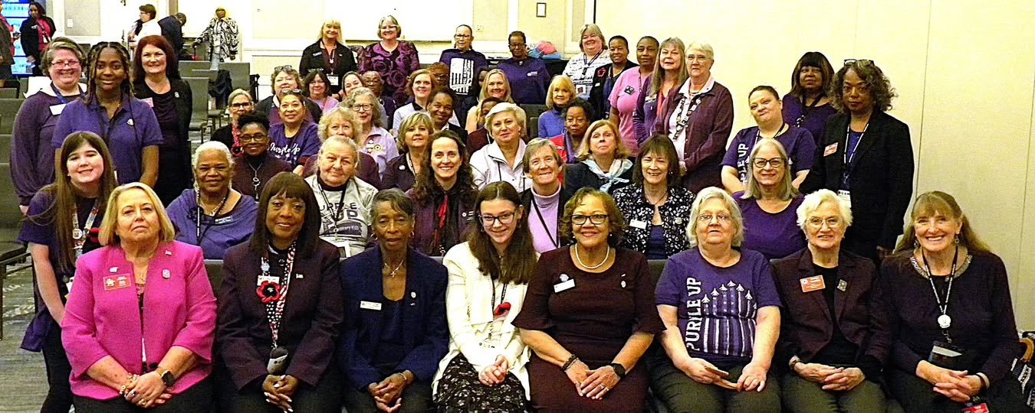
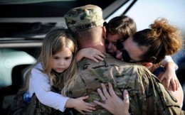
Let’s Raise the Membership Bar Serving Our Veterans, Military, and Their Families
Membership Committee Purpose & Call to Action
The purpose of the Membership Committee is to grow our membership and expand our ability to meet the needs of our Military Veterans, Active-Duty Service Members, and their families. Together, we can create more opportunities to serve—more chances to be the one who makes a difference.

Slide 2
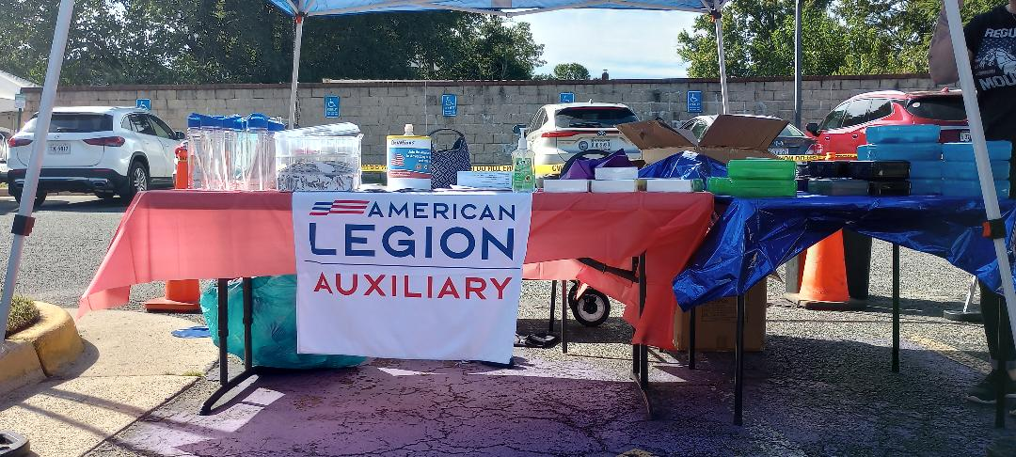

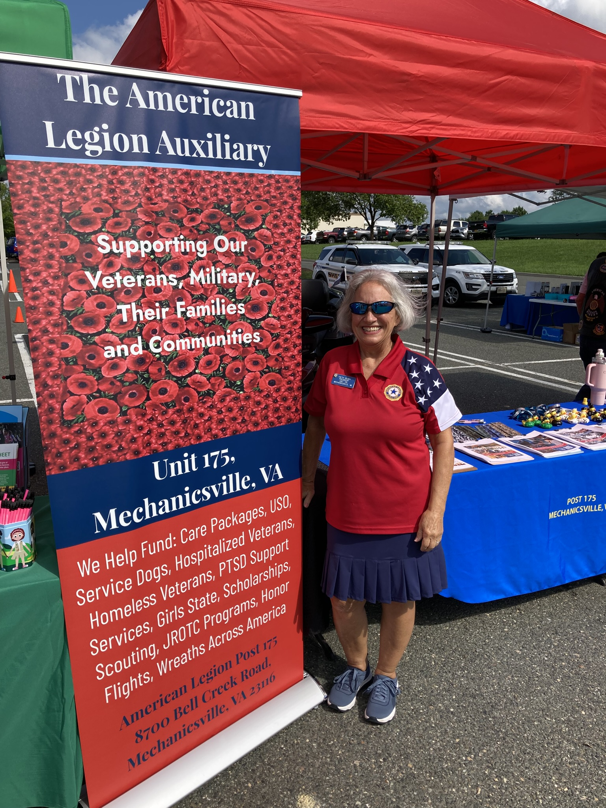
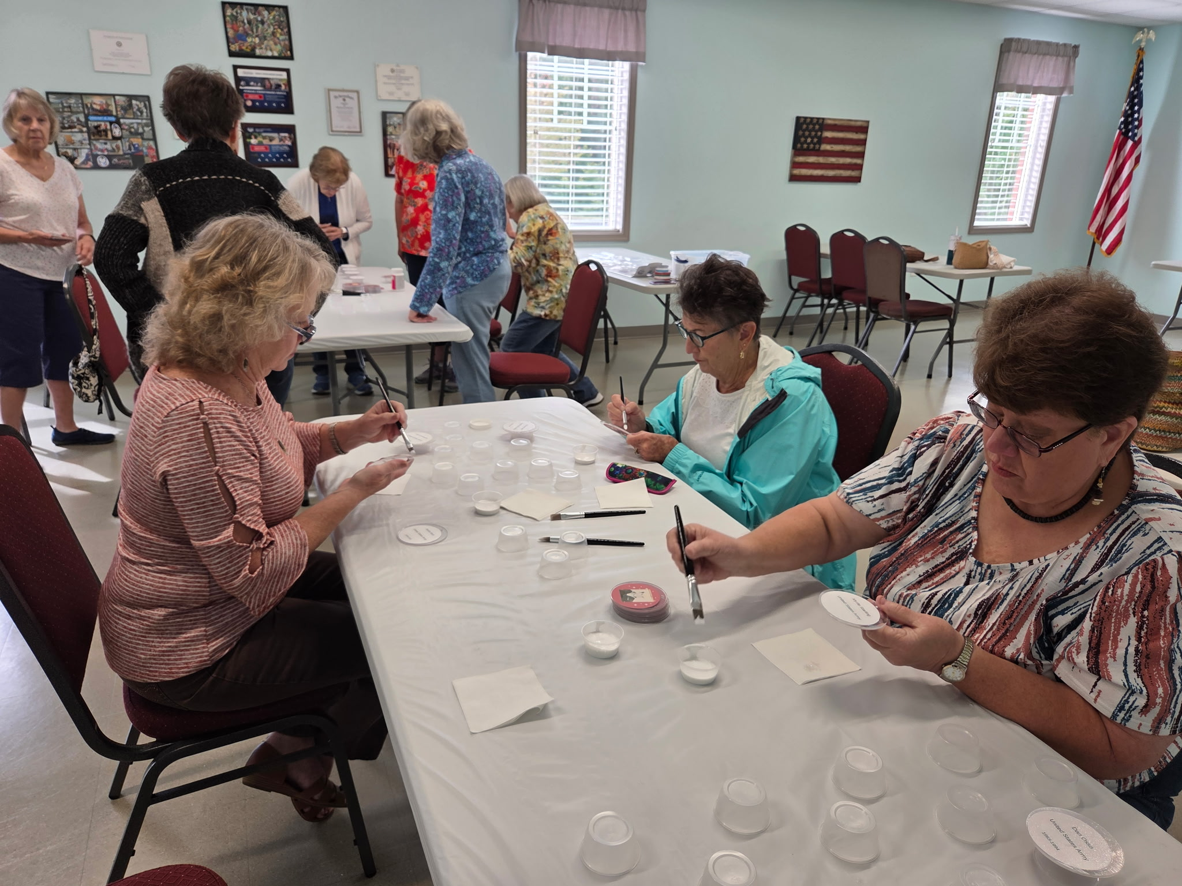
Membership Mid Year Reporting
21 Reports Received
18 Narratives Received

Slide 3


Two Units have achieved their 100% membership goal
Unit 13 Staunton and Unit 127 Floyd Congratulations
There are 12 units who are in 80-90% range
There are 13 who are in the 70% range
There are 19 who are in the 60% range
All the rest of the units are in the 50% or lower.
As of right now the department is a little over 70%.
Let re Let’s reach out to our members who have not renewed. A simple
phone call or a nice card.

Slide 4
Here are some of the highlights of our units.
Unit 5 – Attucks Some of their members reached out to the public to recruit new members. As of November they have reached 77.23% of membership renewals which is the highest in their district.
Unit 280 Chesapeake They have been sending out Birthday Cards to all of their members and to former members to rejoin.
Unit 75 – Gloucester Have applications ready to hand out when at public events.
Unit 49 Dashiell-Barton they promote the ALA at different events in the public at various sites.
Unit 146 Hopewell They have Membership Mondays for anyone to stop in and pay dues, and to ask questions for anyone who is interested in joining and advertising this event.
Unit 186 Held an October Festival and handed out applications.
Unit 284 Colonial Heights Emails sent on regular basis to members.
Unit 329 Dalgren setting up an ALA table at the King George Festival.
Unit 74 Handing out applications where there in the community such as church bazaars, town meetings etc.
Unit 175 Mechanicsville They hold Mahjong gatherings for new members and non-members to recruit and maintain membership.
Unit 215 Goochland Wearing their ALA shirts when ever they go to events which then sparks a lot of questions about the ALA Unit 41 Lloyd Williams Setting up a membership booth at the Clarke County Fair.

Slide 5
Unit 247 Remington also set up a membership booth National Night Out and at the Remington Fall Festival
Unit 176 Springfield Attending all legion events setting up table and activities. Having their annual Christmas party for their community. Their membership is always growing.
Unit 177 Fairfax Unit has special events to promote membership. A unit member sent a new member a welcome letter with all the event that were going on at the unit and post level
Unit 180 Vienna Every third Sunday holding a ALA breakfast to try to get new members.
Unit 1995 Centreville Participate at Centreville days and 6GX Recruitment Event to try to get new members.
Unit 194 Dorie Miller Arlington Members are encouraged to contact a member who do not come to meeting and reminding them to pay their dues.
These are just some examples from units. How about doing some outreach in the community in place like Assisted Living. Let the community know about the ALA through church communications/newsletters. Attending social events at the post and having a laptop there for any one who is eligible to join sign up. Explain that they must provide proper document to complete the application process. Participating in honor flight at post and handing out information on how to join the ALA.
Hosting an event at your post for communities -knitting, holding defense classes, contacting the local police department to ask to come in and give out some information in the community, church bazaars. Contacting your local Civic organization to set up a table during their meetings. These are just a few ideas.

Slide 6
Important Dates
100% Unit Award Deadline: January 31, 2026
85% Department Goal Award Deadline: March 15, 2026
Recruit/Rejoin 10 Award Deadline: June 6, 2026
Family 3 Award Deadline: June 6, 2026
95% Department Goal Award Deadline: June 12, 2026
100% Department Goal Award Deadline: July 4, 2026
102% Department Goal Award Deadline: August 1, 2026
95% Department Retention Goal Award Deadline: August 1, 2026

