Slide 1




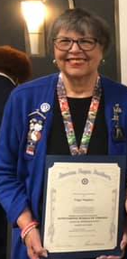

American Legion Auxiliary Dept. of VA Spring Conference
In Memoriam:
Peggy Magahay

Slide 2

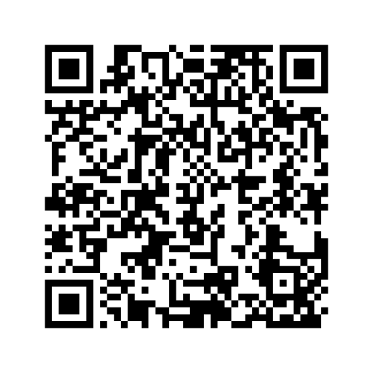


American Legion Auxiliary Dept. of VA Spring Conference
2025-2026
Poppy Order Form

Slide 3

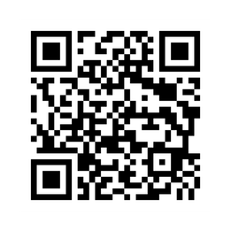
American Legion Auxiliary Dept. of VA Spring Conference
Resources Available from National
- Poppy coloring books
- “Get Involved” ideas on promoting the Poppy Program and increasing donation revenue
- National Poppy Poster Contest and Little Miss Poppy Contest instructions
- Details for ALA units and members on Poppy Program reporting and awards
- Ideas for alternative poppy items to distribute
- Poppy bookmarks, donation can labels, and other related templates

