Slide 1
American Legion Auxiliary Department of Virginia Veterans Affairs & Rehabilitation 2025-2026 “Mission Driven – Serving Our Veterans!”

Slide 2
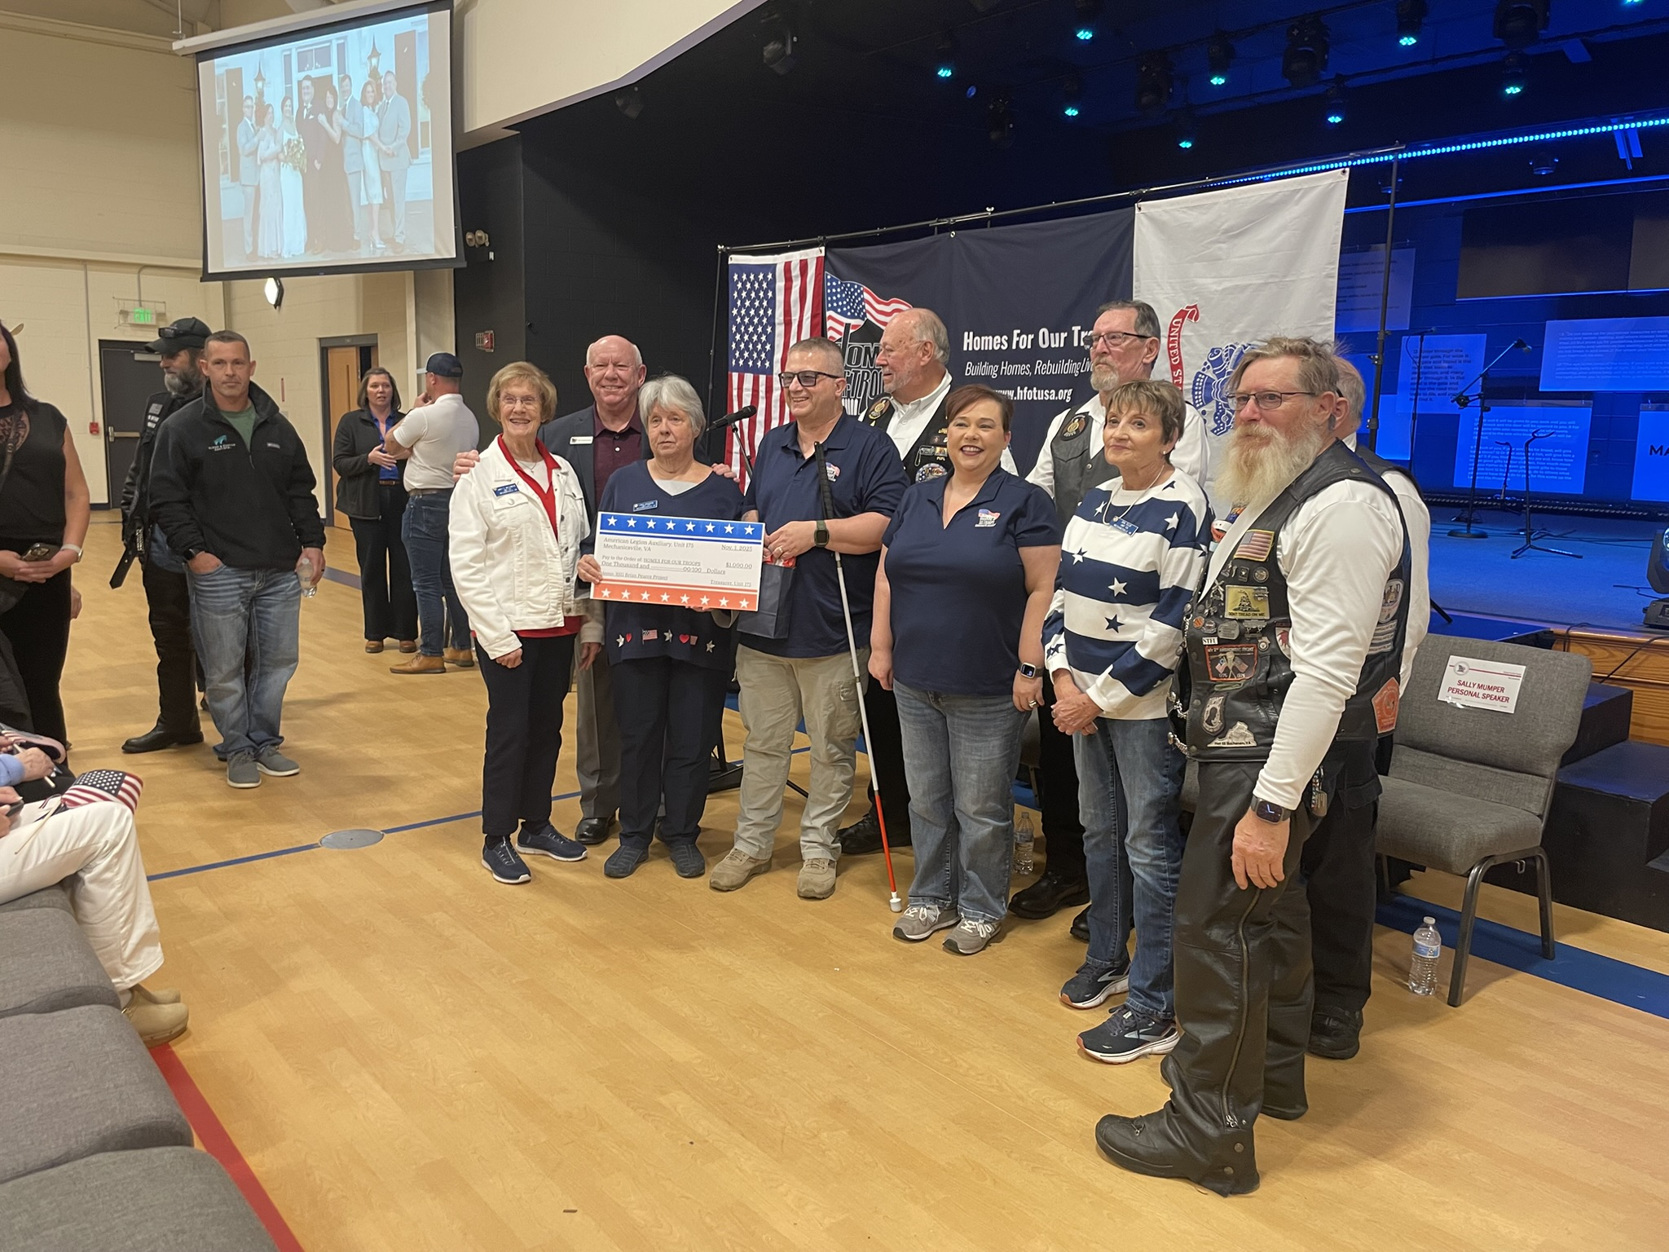
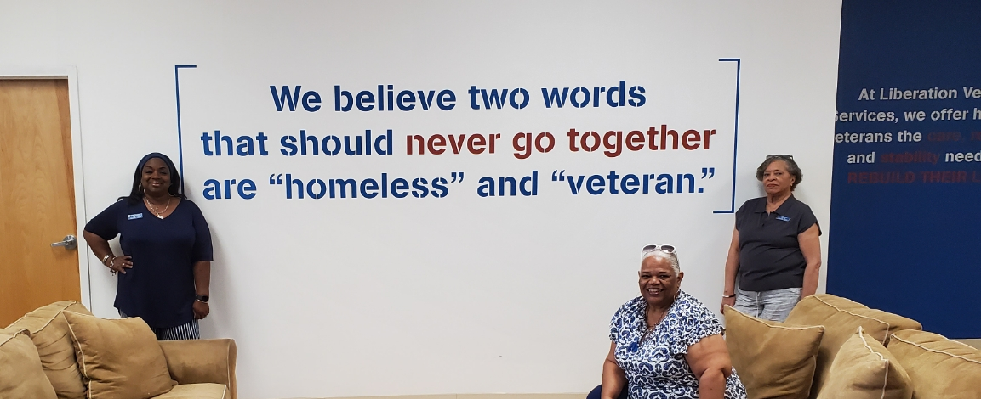
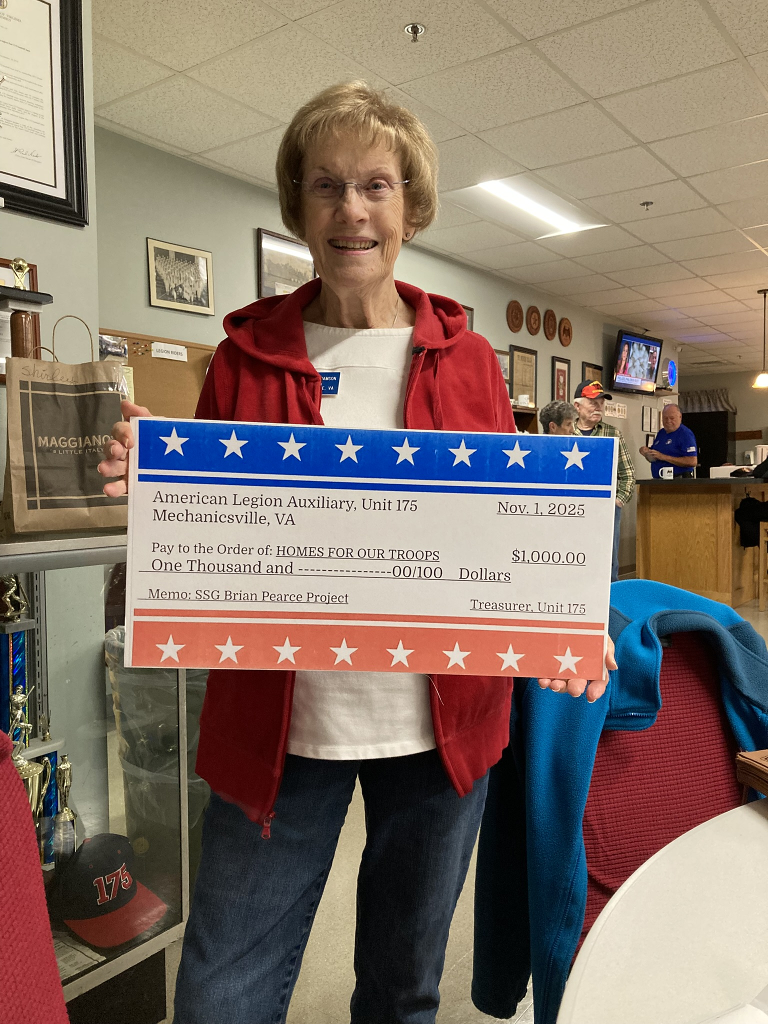
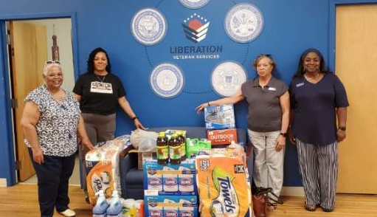
Around the Department
Unit 144 donating supplies to Liberation Veteran Services
Unit 175 donates $1000 to help build a new home for a blind veteran.

Slide 3
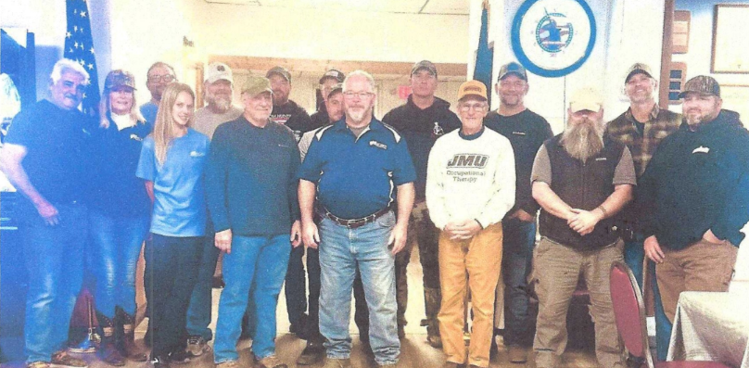
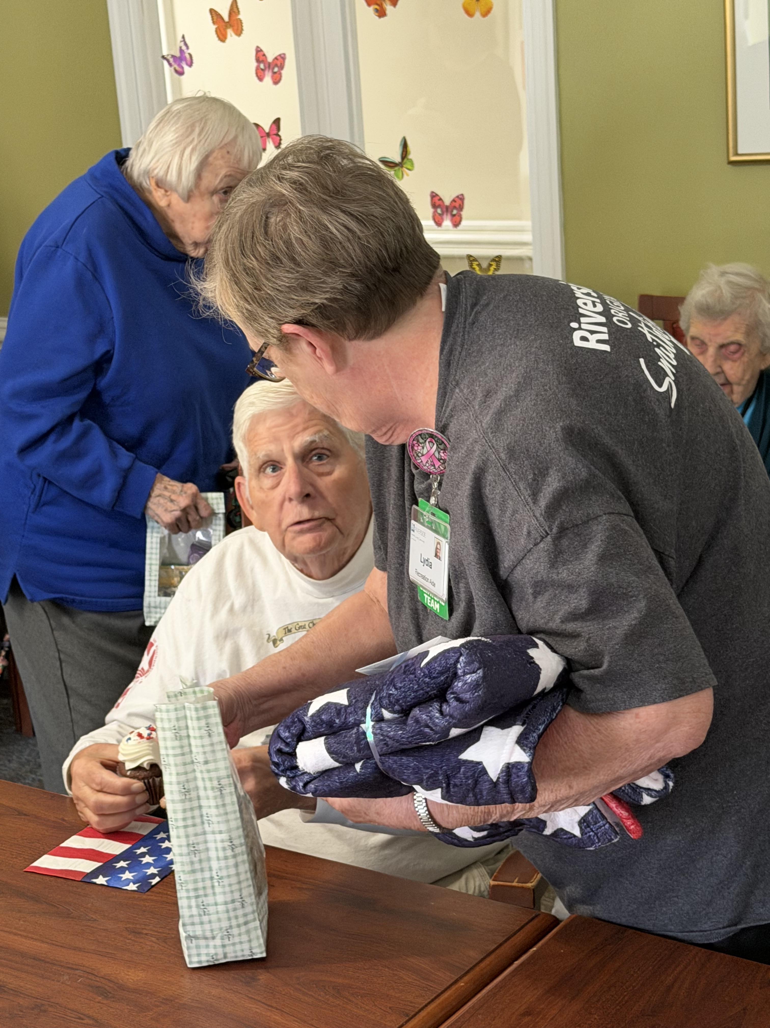
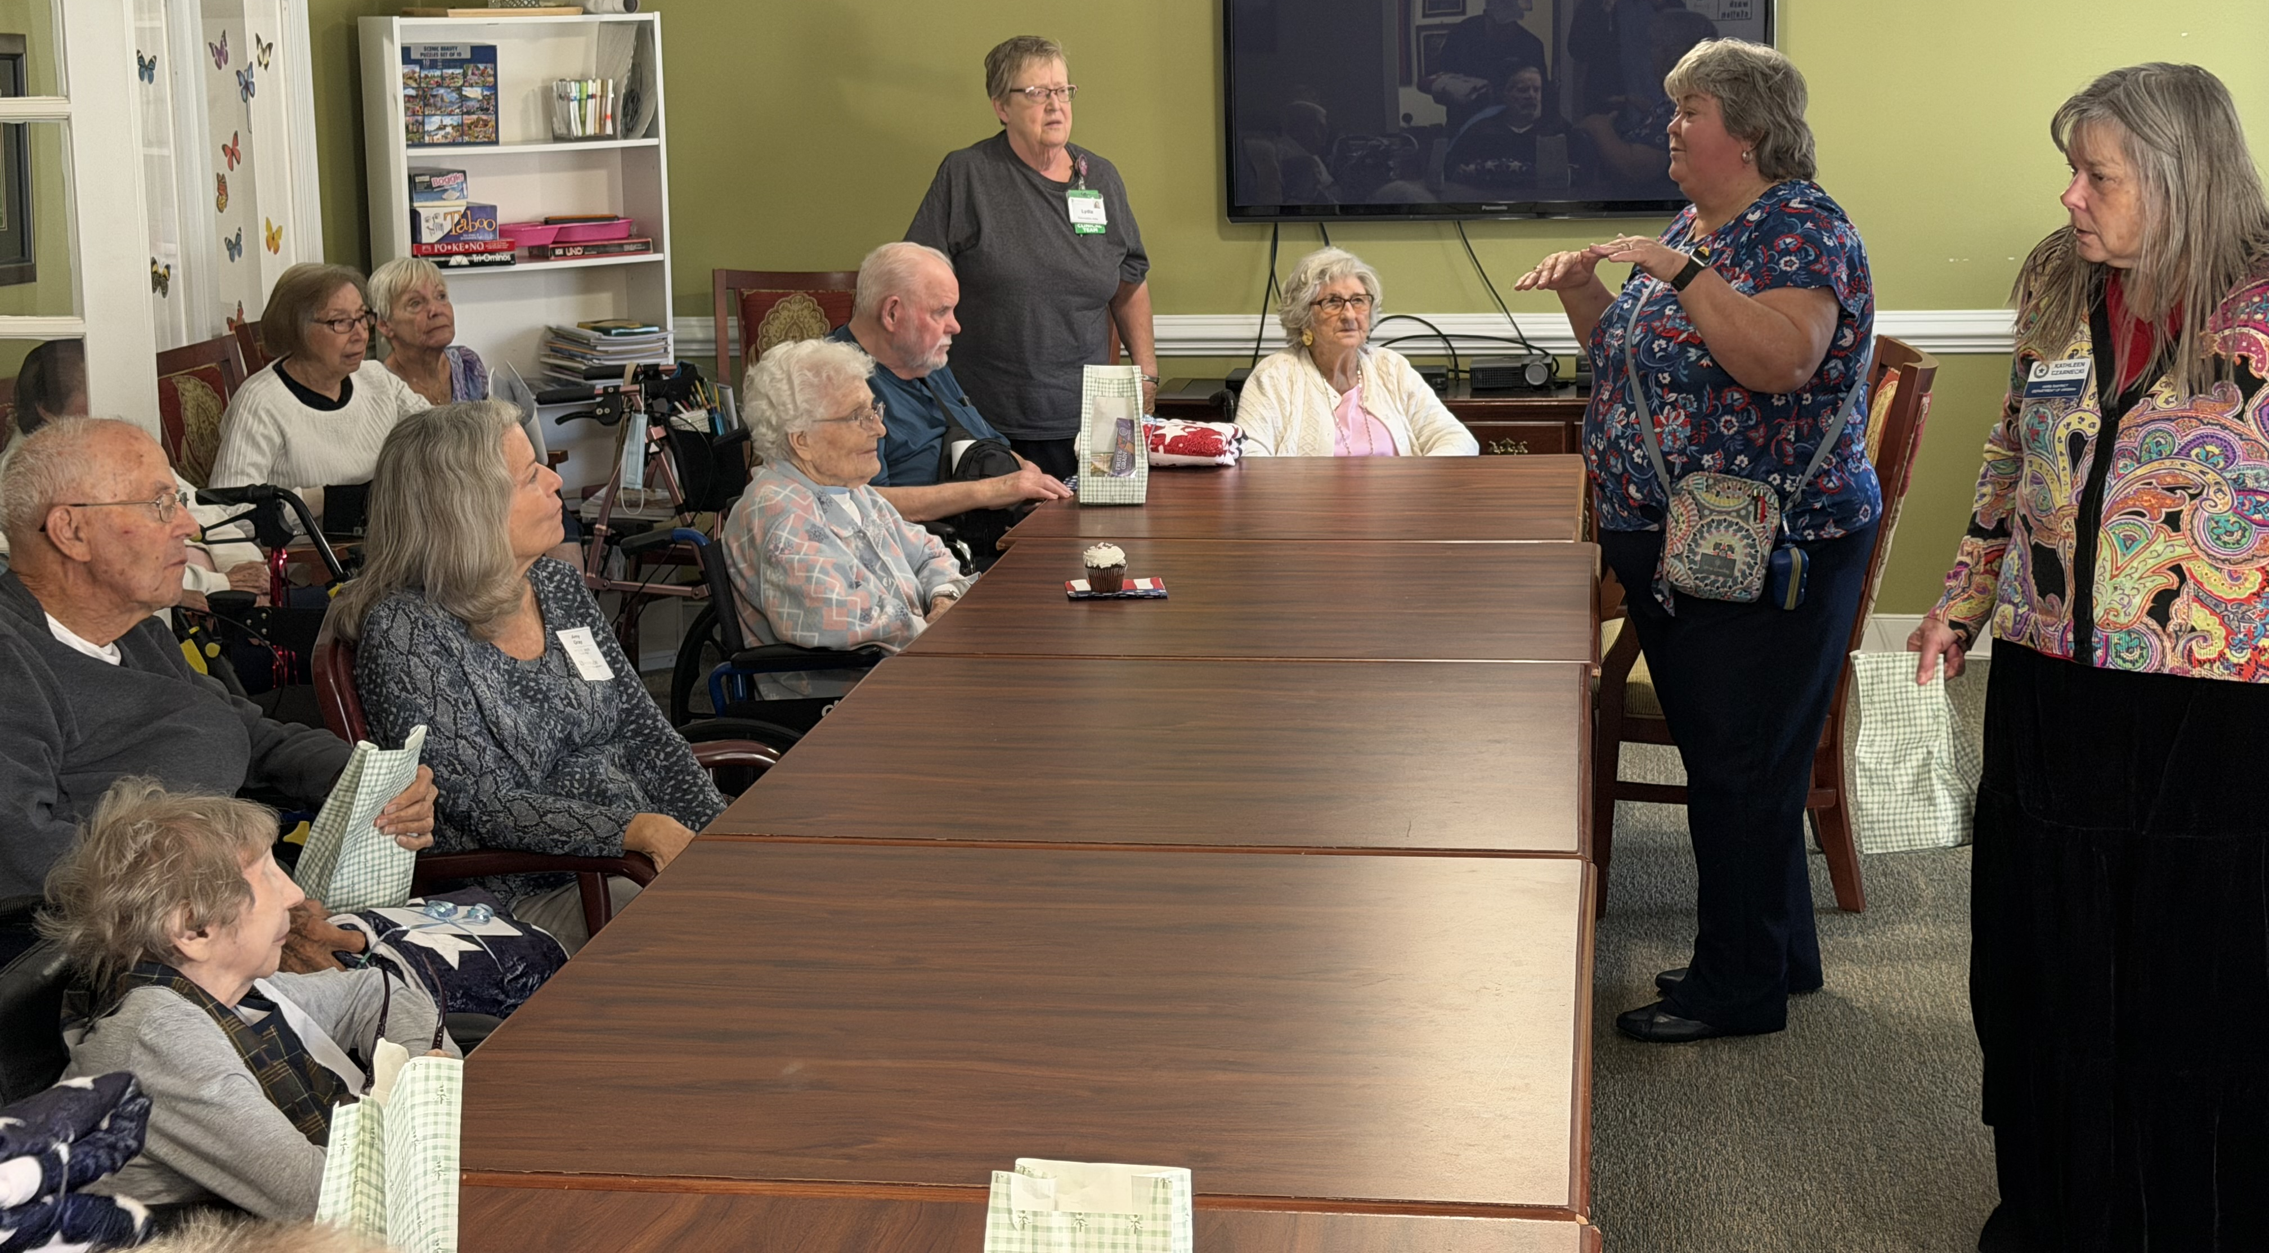
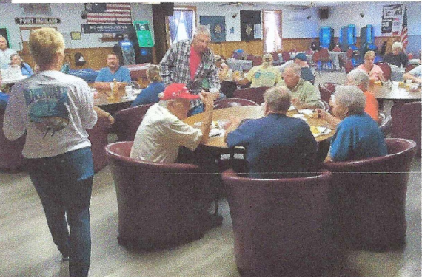
Around the Department
Unit 49 holding Veterans Day Services at a local nursing home
Unit 159 hosting Freedom Hunter dinner and monthly Veterans Café.

Slide 4





Donations to outside partner veteran-oriented organizations
$225 donated
$320 donated
$2371 donated
$3360 donated
$1300 donated

Slide 5

This year’s VA&R Department Project!
It’s never too early to find ways to help with the local VCAF events (held in the fall) – Contact your local VAMC Reps for dates and information!
Know a creative veteran in your community? See if they would be interested in entering their work or displaying their talent at the local level!
Donations so far this year -- $875
2026 National Veterans Creative Arts Festival
June 9-14, 2026
Columbia, SC

Slide 6
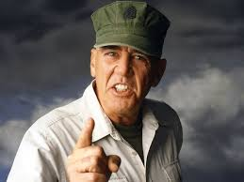
Upcoming Honor Flights
Eastern Zone
April 18
October 17
Northern Zone
May 2 (Loudoun)
May 30 (Winchester)
Oct. 10 (Harrisonburg)
Culpeper if enough interest
Western Zone:
April 17-19
Gunny says “Don’t forget to write a card for your regional Honor Flight Mail Call before you leave!!!”

